Slide 1
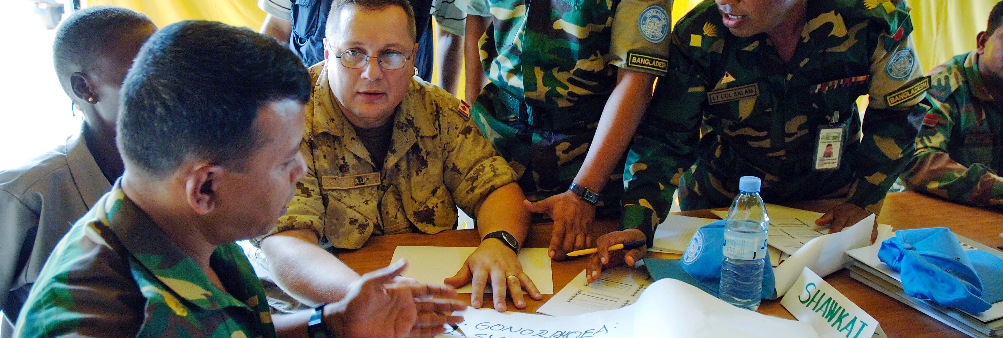
Module 5: MAINSTREAMING CHILD PROTECTION
Notes:
UN Photo/Arpan Munier

Slide 2

Learning objectives
By the end of this module, learners should be able to:
Explain key approaches to mainstreaming
Prepare messages to increase the mission’s support for child protection
Design appropriate child protection trainings for various mission components
Propose options for mission components to engage on child protection

Slide 3
What is mainstreaming?
UNPOL
Civilian sections
CHILD PROTECTION
Military components
SRSG/HOM
Notes:
PHOTO: UN Photo/UNFYCIP

Slide 4
Mainstreaming approaches
Advocacy within the mission
Training
Organizational reform
Child Protection focal points
Mission-wide plans
Policy guidance
Advising senior leadership
Briefings of new staff
Specialized trainings
Requests for support

Slide 5
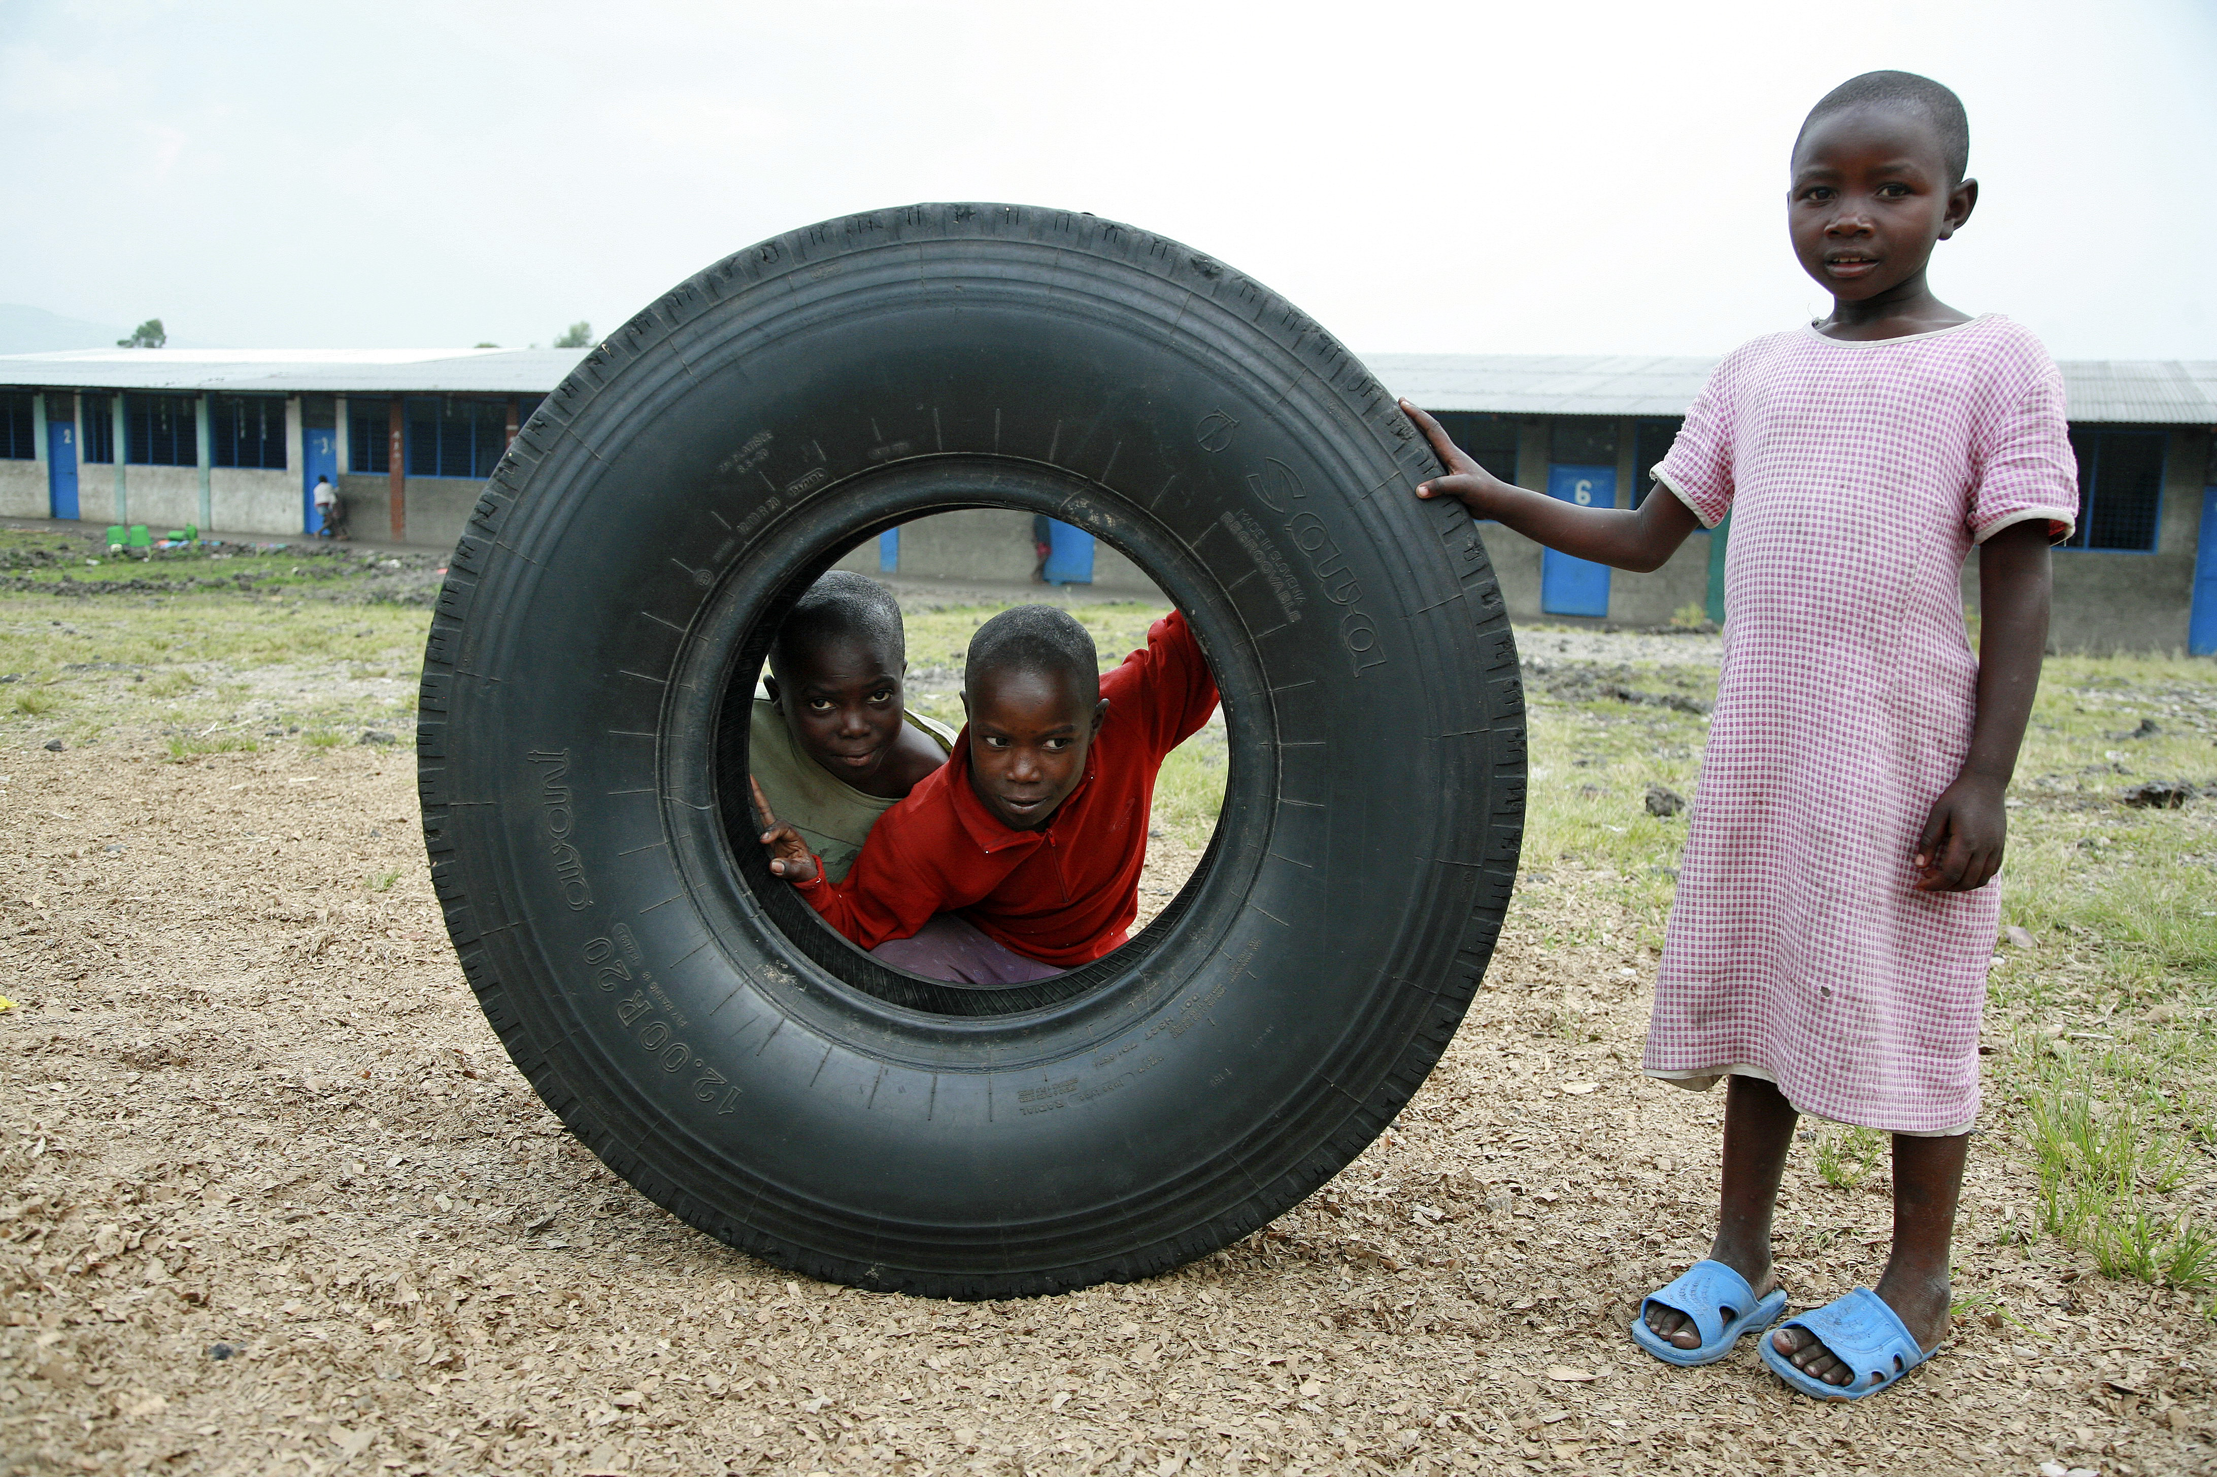
Advocacy within the mission
Make it relevant
Be consistent
Find allies
Decentralize, and...
Notes:
UN Photo/Myriam Asmani

Slide 6
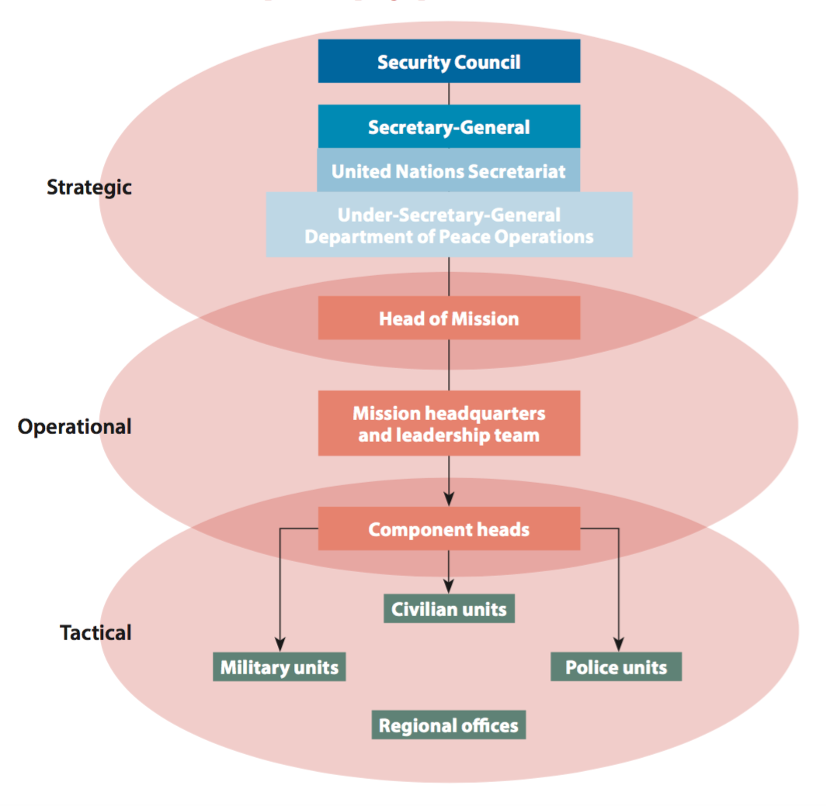
Advocacy within the mission
5. Leverage the mission’s strategic components
UN Security Council Children and Armed Conflict Agenda
Strategic
Operational
Tactical

Slide 7
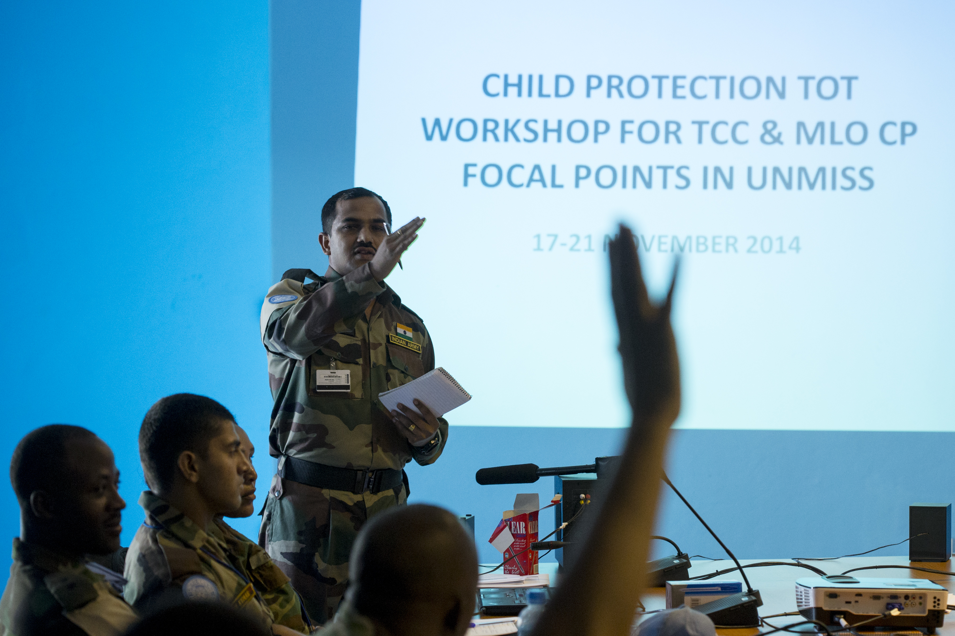
Group discussion: Training for mission components
Which mission components are you currently providing training to, and on what topics?
What could you do to improve training?
How do you know whether your training is working?
Notes:
UN Photo/JC McIllwaine

Slide 8
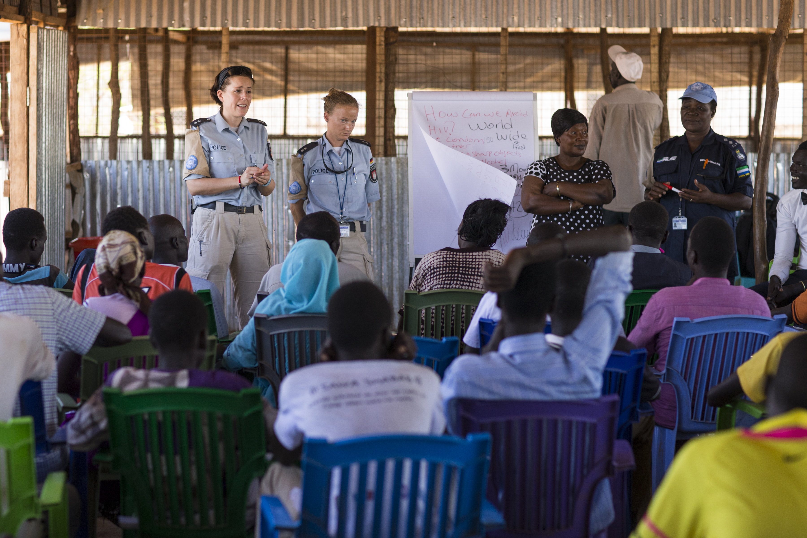
Some practical tips for training delivery
Structure the presentation
Contextualize content
Involve the audience
Use visual aids
Prepare handouts
Notes:
UN Photo/JC McIllwaine

Slide 9
Purpose of organizational reforms
Organizational reforms for child protection mainstreaming in missions aim to:
Empower relevant mission staff to apply child-sensitive approaches
Contribute to the organization’s institutional memory on child protection
Build ownership among mission staff on the child protection mandate

Slide 10
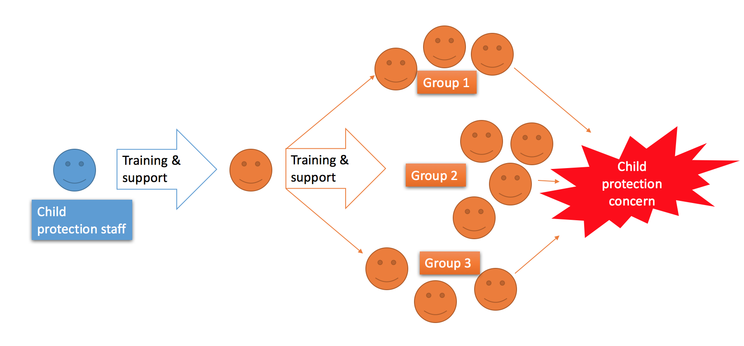
Focal points
CP focal point

Slide 11
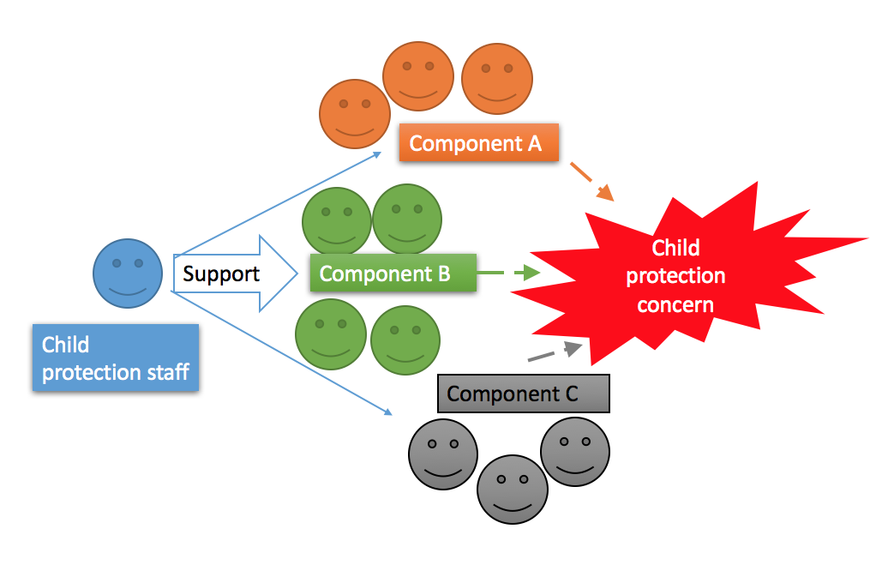
Mainstreaming plans

Slide 12
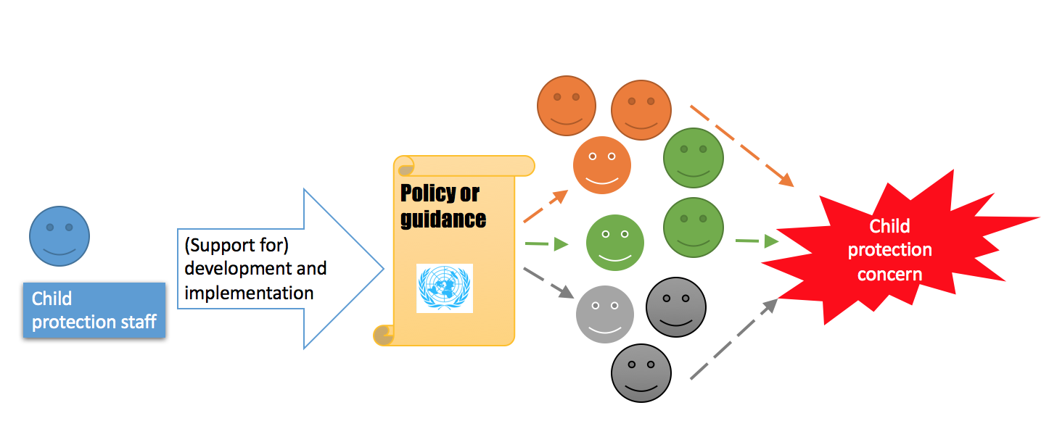
Mission policy and guidance

Slide 13
Group exercise: Mainstreaming plan
Tasks:
Identify a child protection issue in your mission area
Prepare a mainstreaming plan:
Which mission components would you involve as partners?
What actions should they take?
What support would they require from child protection staff?

Slide 14
Takeaways
Leverage the Child Protection Section’s access to mission leadership for advocacy
Adapt your child protection trainings to the specific audience and always ask trainees for feedback
Create options for your colleagues in other mission components to support child protection work
Develop policy or guidance documents to change your mission’s approach on child protection in the long term

