Slide 1
Module 3: ADVOCACY
Notes:
UN Photo/JC McIllwane

Slide 2
Learning Objectives
By the end of this module, learners should be able to:
Create SMART advocacy objectives
Select a target audience
Compose advocacy messages
Assess resources for advocacy

Slide 3
What is Advocacy?
“The process of influencing the host State’s government, armed groups, UN entities, NGOs, donors and other actors to support and implement actions to advance the rights, well-being and protection of children.”
The Manual, p. 34

Slide 4
Advocacy challenges
Lack of coordination
Lack of access
Lack of political leverage
Changing conflict dynamics
Limited ability to demonstrate direct impact

Slide 5
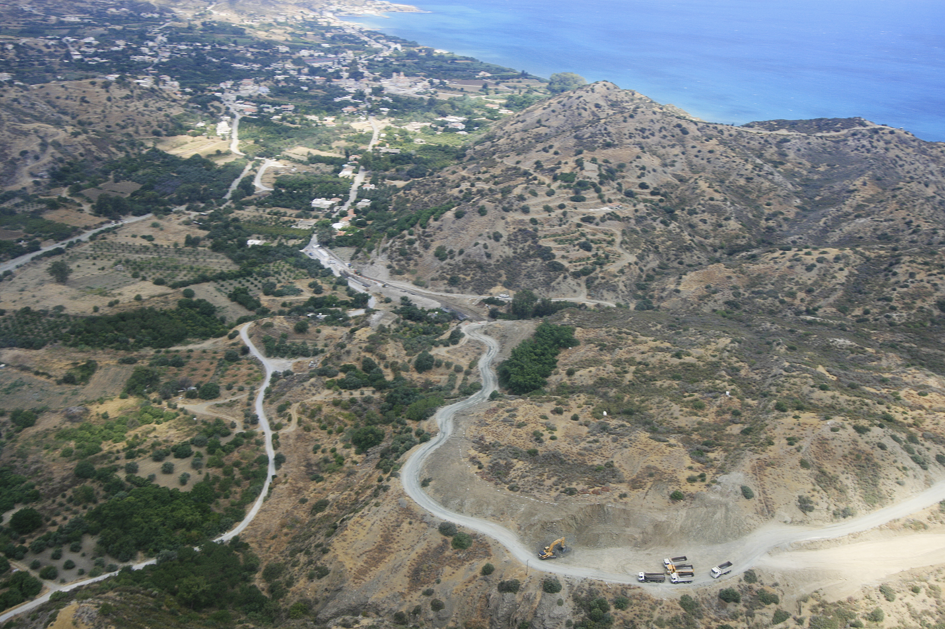
Elements of an Advocacy Strategy
Goals and objectives
Target audiences & allies
Activities
Key messages
Resources
Monitoring & evaluation
Notes:
PHOTO: UN Photo/UNFYCIP

Slide 6
Goals and Objectives
Desired change
Objective 1
Objective 2
Goal
Objective 3

Slide 7
SMART OBJECTIVES
Specific
Measurable
Achievable
Relevant
Time-bound

Slide 8
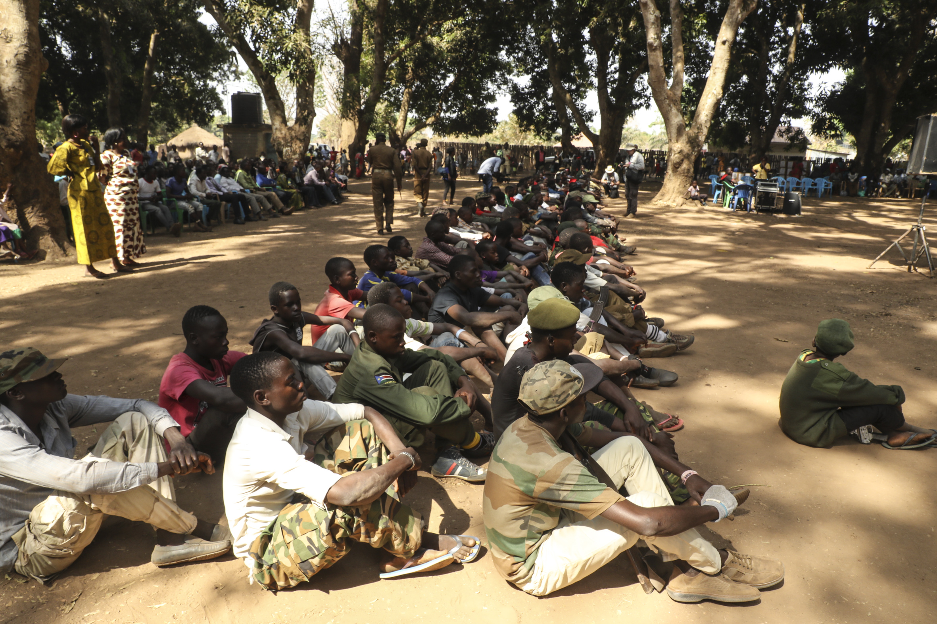
EXAMPLE 1: Is this objective SMART?
Influence parties to conflict to end recruitment and use of children in armed conflict.
Specific?
Measurable?
Achievable?
Relevant?
Time-bound?
Notes:
UN Photo/Isaac Billy

Slide 9
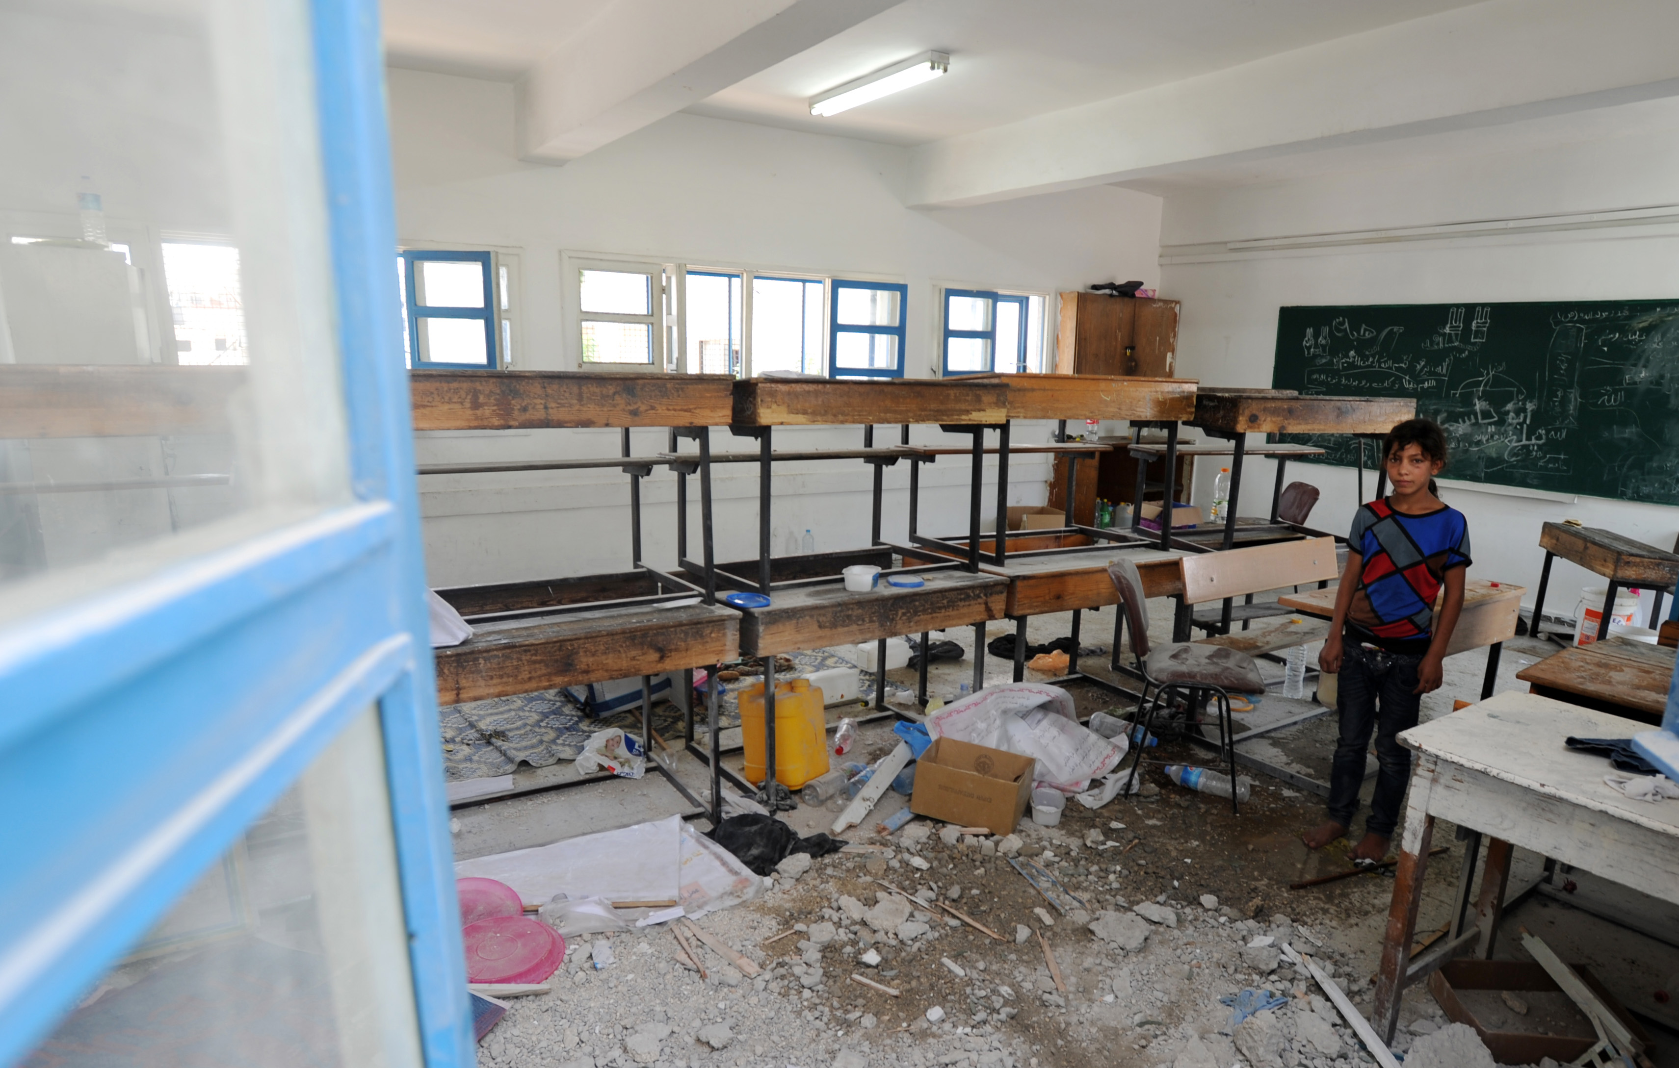
EXAMPLE 2: Is this objective SMART?
By the end of year 2, influence the Host Government’s Ministry of Justice to adopt a new law to protect schools from being used for military purposes, in accordance with the Safe School Declaration Guidelines.
Specific?
Measurable?
Achievable?
Relevant?
Time-bound?
Notes:
UN Photo/Shareef Sarhan

Slide 10
EXAMPLE 3: Is this objective SMART?
Convince donors to increase funding for psychosocial support services for child survivors of gender-based violence for country X.
Specific?
Measurable?
Achievable?
Relevant?
Time-bound?
Notes:
UN Photo/Marine Perret

Slide 11
Target audience
Primary target
Secondary target
Have the access and capacity to influence the primary targets
Have the power to bring about the desired change

Slide 12
Group exercise: Stakeholder analysis
Tasks:
Identify 2-3 influential actors that are primary targets for advocacy on children in armed conflict concerns in your mission context
Discuss the following questions for each of the actors:
What is the actor’s level of interest on this issue?
Is the actor supportive/opposed to the issue(s)?
What are the actor’s motivations and pressure points?
How would you be able to access this actor?
What are potential risks for engaging with the target?

Slide 13
Allies
Value added
Interest aligned
Potential ally

Slide 14
Key advocacy message
Include call for action
Utilize monitoring and reporting work
Build on language from key UN documents
Security Council mandates
SCWG-CAAC conclusions
2017 DPKO/DFS/DPA Child Protection Policy
Create a primary and secondary message

Slide 15
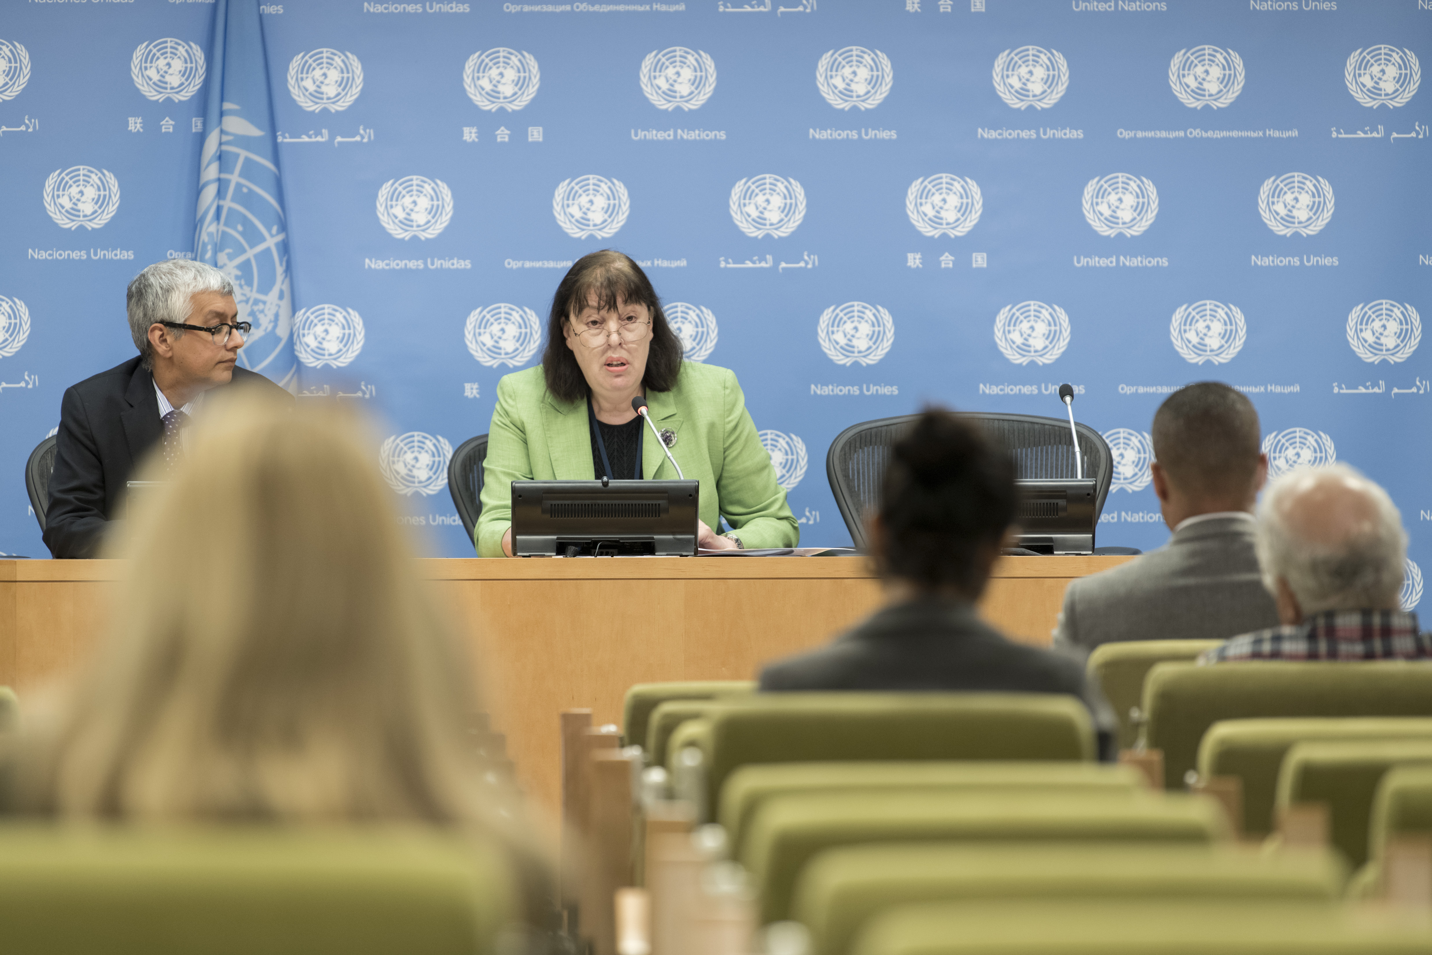
Primary advocacy message
For all audiences:
Start with a compelling statement
Give evidence of the problem
State the desired change
Notes:
UN Photo/Mark Garte

Slide 16
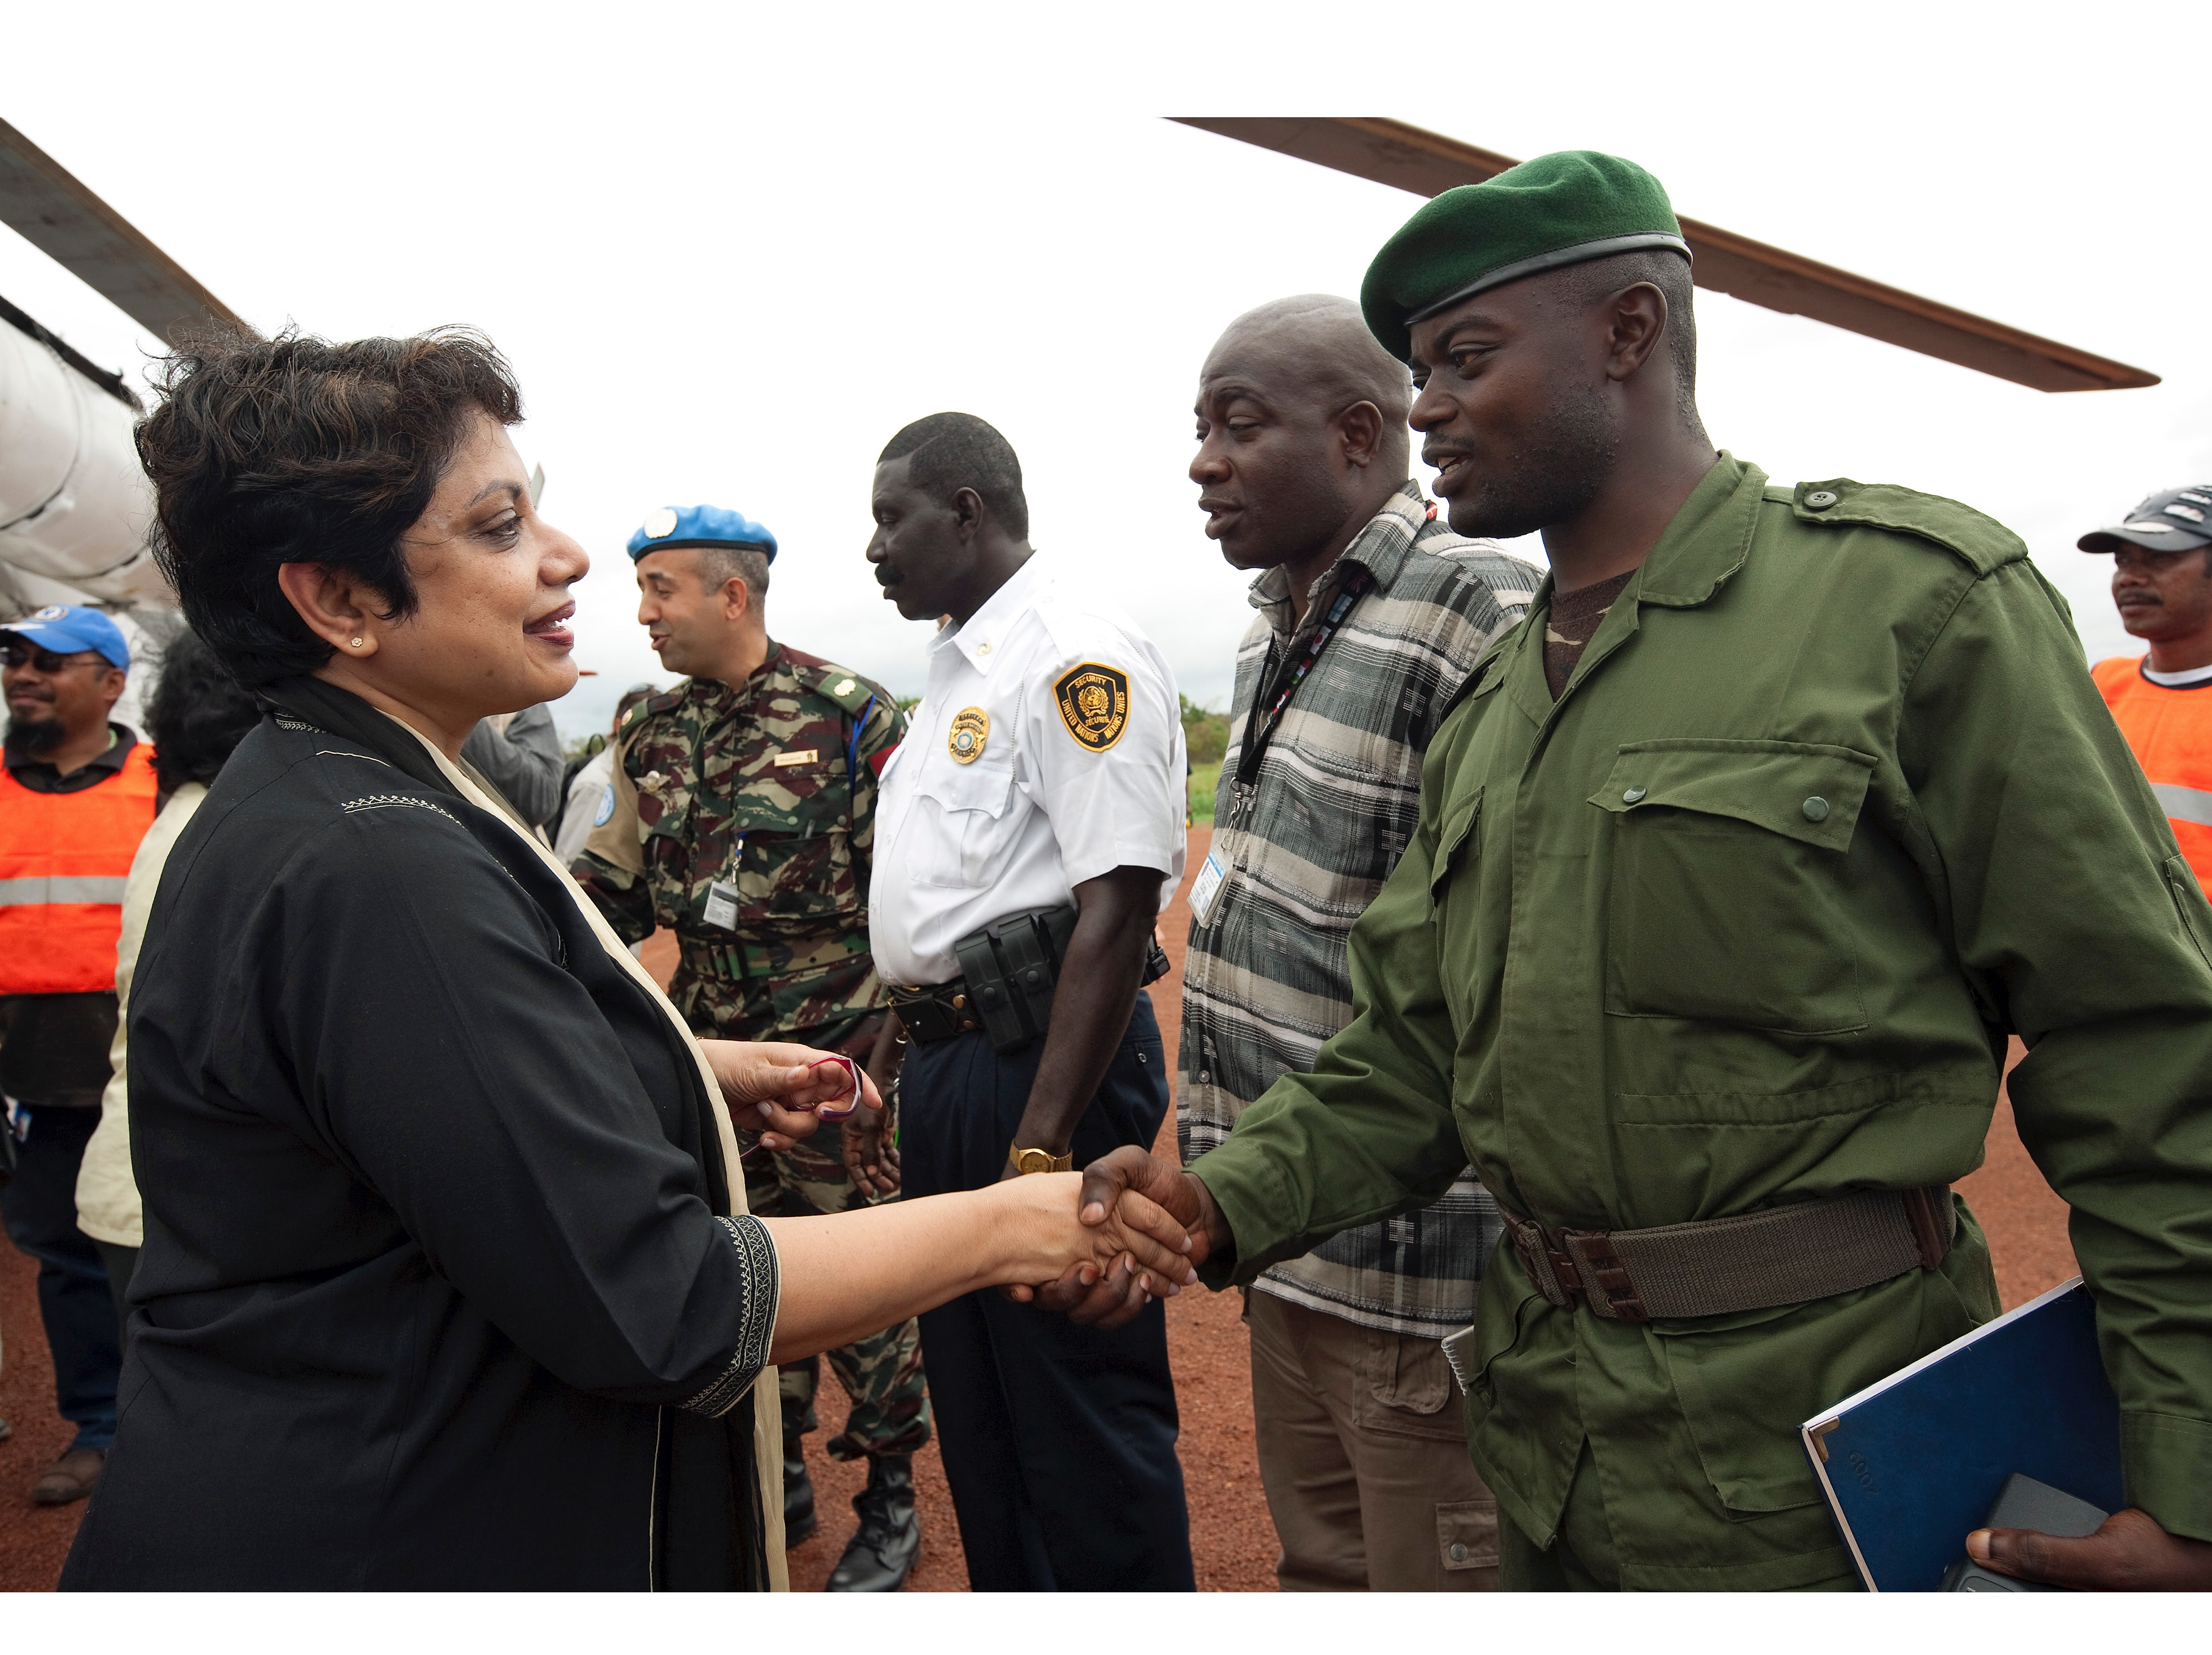
Secondary advocacy message
For specific target audience:
Start with a statement that captures the audience’s particular interests
Give evidence of specific problem(s) and how it concerns the audience
Make a request to the audience
Notes:
UN Photo/Marie Frichon

Slide 17
Group exercise: Key message
Tasks:
Create a secondary message that is specific to your top advocacy target
Determine whether you should convey these messages directly or through other actors
Start with a statement that captures the audience’s particular interests
Give evidence of specific problem(s) and how it concerns the audience
Make a request to the audience

Slide 18
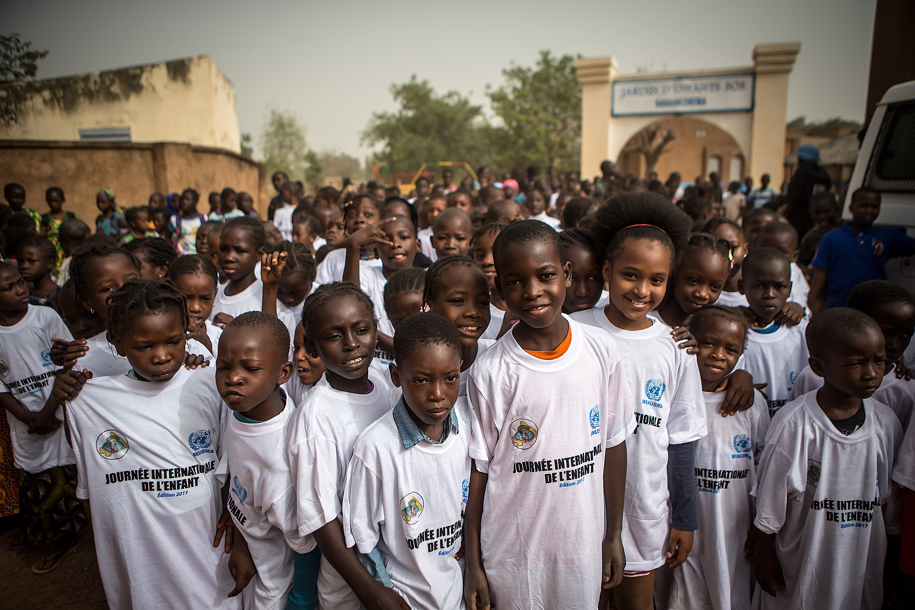
Advocacy activities
Consider:
Timing
Format
Messenger
Resources
Notes:
UN Photo/Harandane Dicko

Slide 19
Advocacy resources
Staff, funding & other support
Child protection staff
UN field mission
Partners

Slide 20
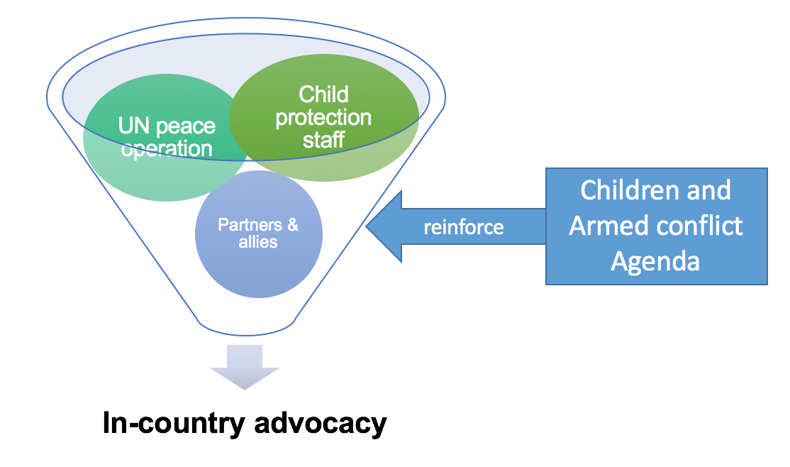
Leveraging the UN Security Council Agenda on CAAC

Slide 21
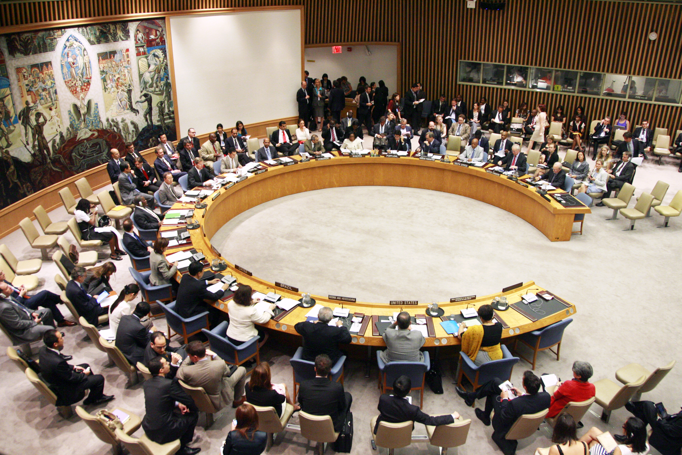
Group Discussion
How are you currently leveraging the UN Security Council CAAC agenda for advocacy?
What is working well?
How can you better leverage the UN Security Council’s CAAC Agenda for advocacy in your mission?
Notes:
UN Photo/Rick Bajornas

Slide 22
Advocacy plan
Put your strategy into action
Clearly assign roles and responsibilities
Determine timeframes
Regularly review the plan and adjust as needed

Slide 23
Takeaways
Strong advocacy is usually well planned
Develop SMART objectives to focus your advocacy efforts
Know your primary advocacy targets and create tailored messages for them
Fully utilize your resources, including your direct link to the UNSC CAAC Agenda

