Slide 1
LEARNING PROGRAMME ON THE PREVENTION OF SEXUAL EXPLOITATION AND ABUSE
GUIDANCE FOR FACILITATORS OF CLASSROOMS SESSIONS
Conduct and Discipline Unit
February 2018
Notes:
Welcome points
Thank you for giving us the opportunity every year to provide an update on the latest on conduct and discipline, including SEA.

Slide 2
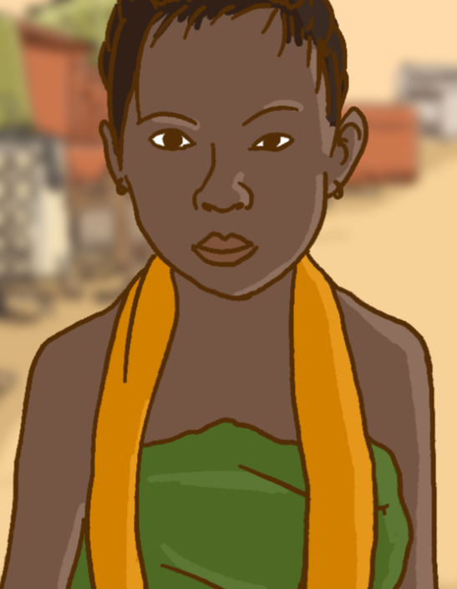
Guidance on…
Course content and targets
Formats available
Facilitation of classroom sessions
Notes:
Building on the initiatives over the past few years, last year, the Secretary-General issued his report on special measures with a new approach.
The four areas of focus as represented here are aimed at enhancing the focus on key areas to support victims and in prevention and enforcement.
Some of these, as pertain to peacekeeping and partnership with Member States will be highlighted today, and other areas will be detailed, as mentioned, in the next special measures report.

Slide 3
Content and target
The course comprises common core lessons for all personnel and a specific lesson for managers and commanders.
All personnel (including Managers and Commanders):
Lesson 1: UN standards
Lesson 2: Consequences for abusers
Lesson 3: Obligations for UN personnel
Assessment: multiple-choice questionnaire of 10 questions
Additional lesson and assessment for Managers and Commanders:
Lesson 4: Managerial and command responsibilities
Additional assessment: multiple-choice questionnaire of 10 questions on 2 scenarios:
2 scenarios for managers
2 scenarios for commanders
Notes:
Building on the initiatives over the past few years, last year, the Secretary-General issued his report on special measures with a new approach.
The four areas of focus as represented here are aimed at enhancing the focus on key areas to support victims and in prevention and enforcement.
Some of these, as pertain to peacekeeping and partnership with Member States will be highlighted today, and other areas will be detailed, as mentioned, in the next special measures report.

Slide 4
Formats available
The course is now available in French, and both the English and French versions have been made available in different formats to best respond to local resources (limited internet connection and computers available) and contexts:
self-paced
The online self-paced format:
The e-learning course is available:
on Inspira (mandatory learning section) for all personnel who have a “@un.org” email address.
on the United Nations System Staff College (UNSSC) platform for those who do not have a “@un.org” email address.
The self-paced off-line additional resource:
The course booklet should be printed and handed over to personnel who have attended a classroom session and who do not have an easy access to a computer and internet connection, so that they can refer to it when needed.
It is however not advised to replace a classroom session by the booklet only.
on-line
off-line
The online classroom format:
The e-learning course available on Inspira or the UNSSC platform can be used in a classroom format if a good internet connection is available but there are insufficient individual computers at personnel’s disposal to take the course.
The assessment must be taken on paper by each participant right after the class.
The classroom off-line format
The course lessons are available as PowerPoint presentations and can easily be used if the internet connection is not available or reliable.
The assessment must be taken on paper by each participant right after the class.
classroom
Notes:
Building on the initiatives over the past few years, last year, the Secretary-General issued his report on special measures with a new approach.
The four areas of focus as represented here are aimed at enhancing the focus on key areas to support victims and in prevention and enforcement.
Some of these, as pertain to peacekeeping and partnership with Member States will be highlighted today, and other areas will be detailed, as mentioned, in the next special measures report.

Slide 5
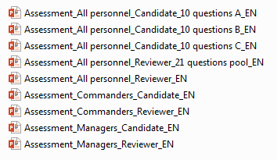
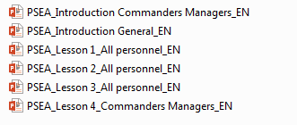
The classroom off-line format:
Which PowerPoint presentations should you use?
Lessons
Assessment
3 versions (A/B/C) of the all-personnel assessment have been developed. Facilitators must choose one and use the others in case some personnel fail the first version of the assessment.
or
All personnel
or
or
Managers
or
and
or
Commanders
or
and
Notes:
Building on the initiatives over the past few years, last year, the Secretary-General issued his report on special measures with a new approach.
The four areas of focus as represented here are aimed at enhancing the focus on key areas to support victims and in prevention and enforcement.
Some of these, as pertain to peacekeeping and partnership with Member States will be highlighted today, and other areas will be detailed, as mentioned, in the next special measures report.

Slide 6

Facilitation of classroom sessions
Before the class
Size of the group: it is recommended to have a group of 12 to 30 participants
Forming the group: different options can be considered depending on the number and role of personnel to be trained:
A group composed only by non managers/commanders personnel.
A group composed only by managers/commander.
A mixed group managers/commanders and other personnel.
Logistics:
Book an adequate room with a large screen and a projector; if the group is mixed, book a second group where non managers/commanders would take the assessment while you deliver lesson 4 intended for managers/commanders.
Print out the participant booklet, the assessments, as well as the certificate of completion of the course.
Fill in the completion certificates with the name of each participant and have them signed by the head of the Missions/Unit.
Notes:
Building on the initiatives over the past few years, last year, the Secretary-General issued his report on special measures with a new approach.
The four areas of focus as represented here are aimed at enhancing the focus on key areas to support victims and in prevention and enforcement.
Some of these, as pertain to peacekeeping and partnership with Member States will be highlighted today, and other areas will be detailed, as mentioned, in the next special measures report.

Slide 7
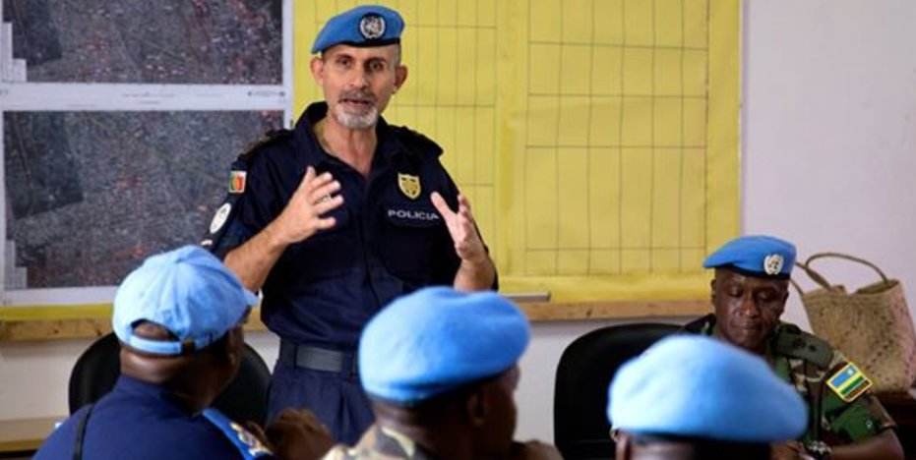
Facilitation of classroom sessions
During and after the class
The course has initially been designed to be a self-paced course, the content is therefore self-explanatory.
As a facilitator, your role is to present the content and create some interactivity with participants where required in the course (please refer to the annotations in the PowerPoint slides).
Most of the questions participants may have should be answered to in one of the lessons of the course. If are not sure how to answer certain questions, park the question, ask a subject matter expert after the class and then provide the answer to the group by email.
After presenting the lessons, hand out the participant booklet and the assessment to the participants. Allocate 30 minutes for the all-personnel questionnaire and additional 30 minutes to managers/commanders for their respective scenario based questionnaire. The participants should complete the assessment individually but can refer to their booklet during the assessment.
Review the assessment with the participants and provide explanations for right and wrong answers using the reviewer versions of the assessment materials which includes answers and explanations. The classroom format does not lend itself to repeating the assessment until all participants have a 100% passing score. Therefore, there is no passing score for the assessment. Offer participants who made mistakes to the all-personnel questionnaire the possibility to take another version of the test at home if their wish to exercise.
Hand out the completion certificates to all the participants.
Notes:
Building on the initiatives over the past few years, last year, the Secretary-General issued his report on special measures with a new approach.
The four areas of focus as represented here are aimed at enhancing the focus on key areas to support victims and in prevention and enforcement.
Some of these, as pertain to peacekeeping and partnership with Member States will be highlighted today, and other areas will be detailed, as mentioned, in the next special measures report.

Slide 8

UNITED NATIONS | FIELD SUPPORT

