Slide 1
Apprehension, Arrest and Detention
in UN Peace Operations

Slide 2
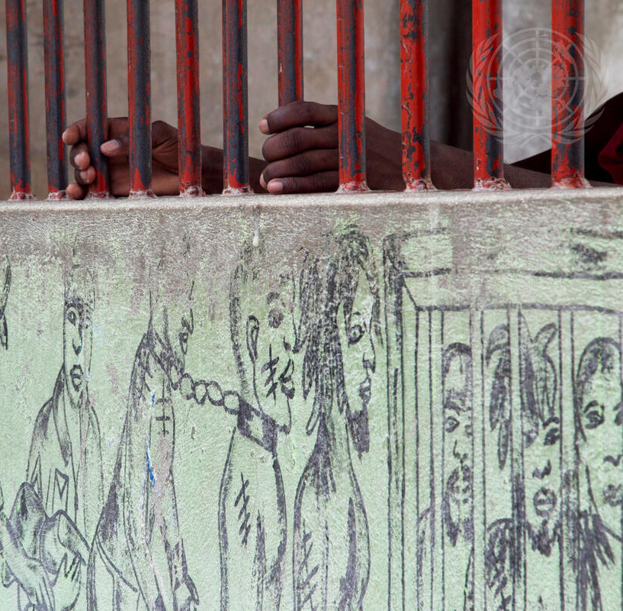
Aim
To familiarise participants with international standards on apprehension, arrest and detention that the host-State police as well as UNPOL must follow

Slide 3
Relevance
Apprehension, arrest and detention are core police activities subject to detailed due process guarantees.
UNPOL who monitor, mentor and advise the host-State police on apprehension, arrest and detention must base their work on international human rights standards.
UNPOL may apprehend and detain persons in application of POC mandates as specified by the Directives on Detention, Searches and Use of Force (DUF) and following Standard Operating Procedures (SOPs) which apply international standards to United Nations Peace Operations.

Slide 4
Learning Objectives
Describe international standards on due process and humane treatment regarding apprehension, arrest and detention
Explain procedures on apprehension, arrest and detention in Peace Operations, as well as roles and responsibilities of UN personnel
Describe special procedures in cases of child detention
Comply with procedures on the release or handover of detainees to the host-State

Slide 5
Lesson Overview
Key definitions
Due process during arrest and detention
Humane treatment in detention
Monitoring places of police detention
DPO SOP on detention in Peace Operations

Slide 6
Key Definitions
Arrest
The act of apprehending a person for the alleged commission of an offence or by the action of an authority
Detained Person
Person deprived of personal liberty except as a result of conviction
for an offence
Apprehension
The act through which an individual is placed under the effective control or custody of United Nations personnel
UN missions without executive mandate carry out apprehensions under their self-defence or protection of civilians mandate

Slide 7
Human Rights Arrest/Apprehension and Detention
Respect for human dignity
Legality &
Due Process
Necessity
Fundamental Human Rights relevant to arrest and detention
Non-discrimin-ation
Proportion-ality
Accountability

Slide 8
Scenario 1
Late on a Friday evening the CNP station in Akkabar receives a report of a brawl in the red-light district. As CNP police officers arrive on the scene they encounter two groups fighting each other in front of a bar. CNP officers witness that both groups attack each other physically, some of them with their bare hands, others with chairs and other items that they picked up from the bar. The crowd quickly disperses as they recognize the CNP’s arrival. CNP officers manage to arrest two men and a woman who took part in the brawl. All three suffered minor injuries, bruises and small cuts.
Question 1
What steps must CNP take as they conduct the arrest?

Slide 9
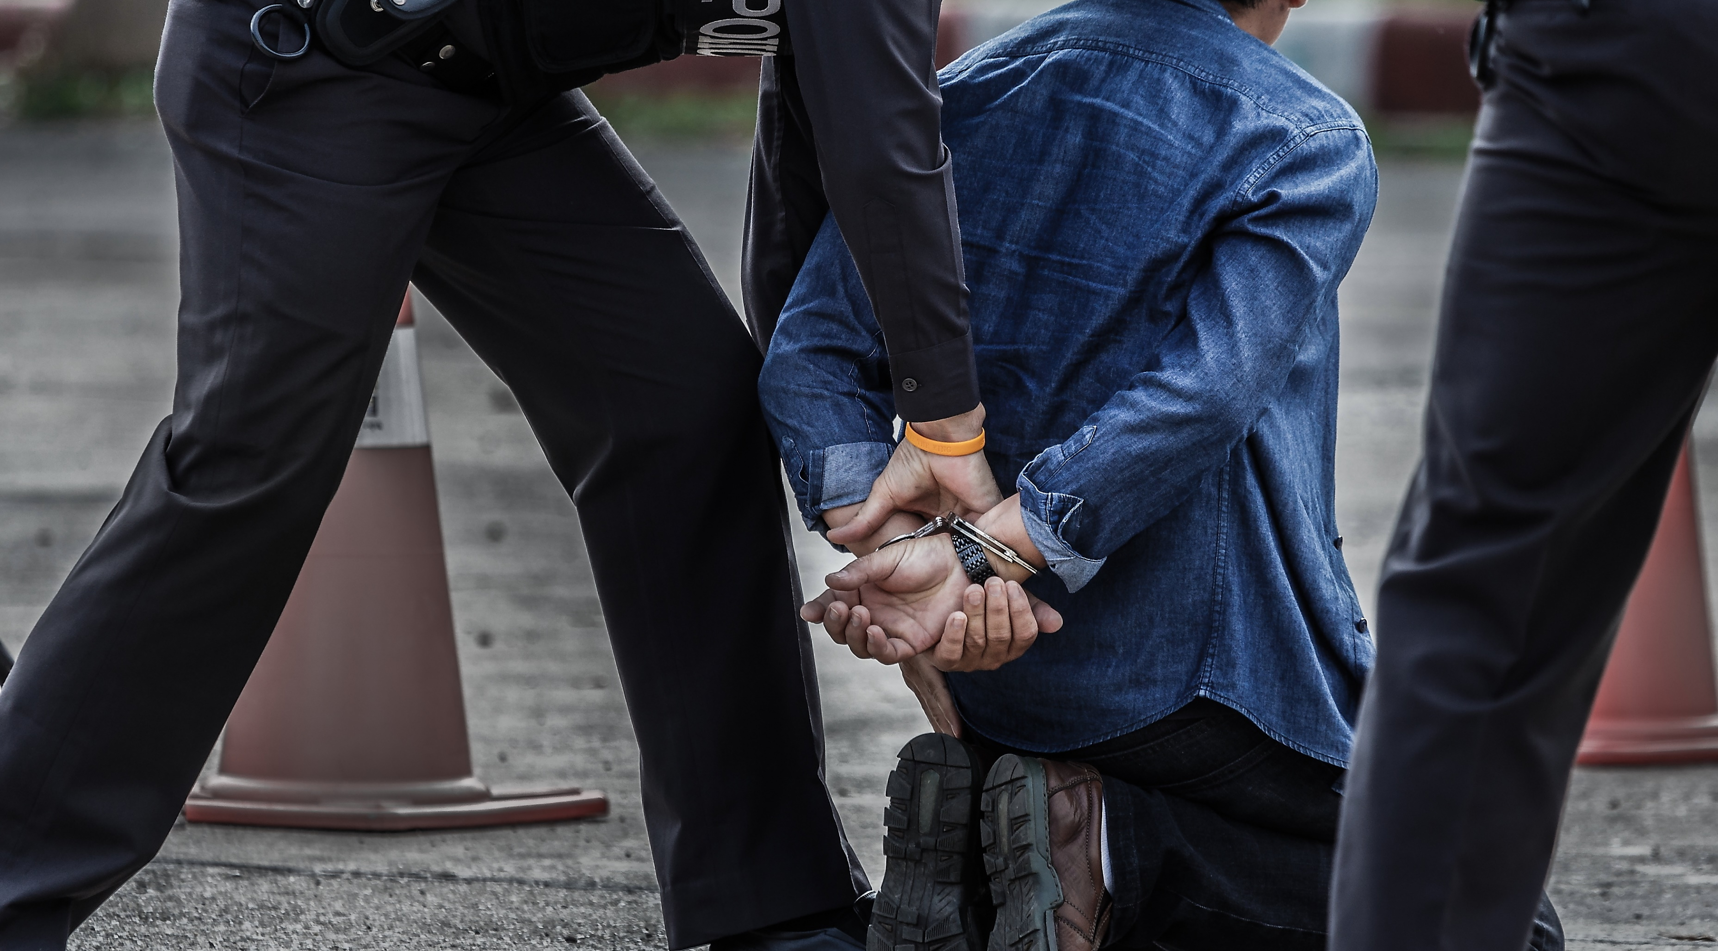
Due Process Standards: Host-State Arrests (including with UNPOL support)
1
2
3
4
Inform person of reasons for arrest
Inform person promptly of their rights
Ensure understanding (language/ interpreter)
Keep detailed arrest and custody records

Slide 10
Scenario 2
The two men and the woman who were arrested are brought to the police station. One man is 16. Under Carana law he is regarded as a child.
Question 1
What due process must the CNP follow to comply with international standards on apprehension, arrest and detention?

Slide 11
Right to Medical Care and Dignified Treatment
Access to medical doctor
Freedom from torture or cruel, inhuman or degrading treatment
Food, water and sanitation, exercise, clothing, bedding

Slide 12
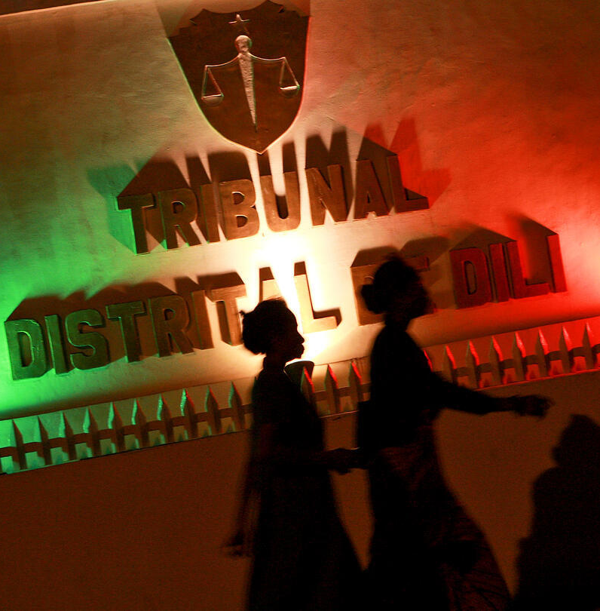
Right to Lawyer and Notification of Family
Access to lawyer without delay, consultation in full confidentiality
Notification of family or other persons of choice, including diplomatic mission

Slide 13
International Separation Standards to Protect Detainees
ADMINISTRATIVE (i.e. migrants) | UNCONVICTED |  | CONVICTED
Women (and where necessary, LGBTI persons) |  | Men
Children |  | Adults
Ordinary detainees |  | Dangerous detainees
Persons with physical ailments – in medical facilities |  | Persons with mental disabilities – in psychiatric care facilities

Slide 14
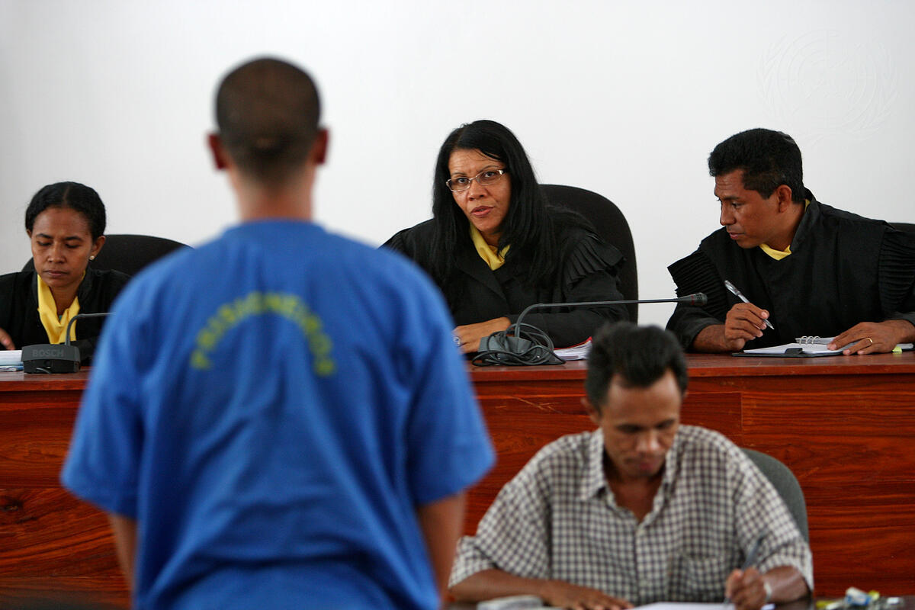
Right to Judicial Review of Legality
Bring person promptly before judicial authority
Maximum 48h (24h for children), otherwise release

Slide 15
Scenario 3
The officer in charge of the detention facilities at the Akkabar police station is uncertain about his obligations towards detainees. The regular visits from UNPOL at the station make him feel insecure. You sense that he is not firm regarding the due process and the legal framework.
Question 1
What should the officer be aware of regarding:
legality of detention,
treatment in detention and
basic procedures regarding the detention facilities?

Slide 16
Arrest and Custody Focus Areas
Legality of Detention
Valid reason for arrest
Due process upon arrest
Right to judicial review
Incommunicado detention
Proper registration / Secret detention

Slide 17
Arrest and Custody Focus Areas
Treatment in Detention
Humane conditions (food, water, health etc.)
Prohibition of torture & ill-treatment
Separation of detainees
Detainees with special needs or vulnerabilities

Slide 18
Facilities Basic Procedures
Check detainee register for abnormalities and accuracy
Periodically visit entire police holding facility
Insist on confidential interviews with detainees
Protect detainees against reprisals
Mentor and advise host-State police as needed
Record concerns and share with human rights component

Slide 19
Scenario 4
Imagine that it was not CNP who arrived first at the scene of the brawl in front of the bar, but UN IPOs and a small FPU detachment.
Question 1
How should UNPOL react to the situation as they encounter it? Do you have to differentiate between IPOs and FPUs?
Question 2
Which documents determine the rights and obligations of UNPOL under these circumstances?

Slide 20
Legal Basis UNPOL Apprehension and Detention
Permitted ONLY in circumstances where the use of force is authorized by the mission’s mandate and set out in the mission’s Directive on the Use of Force (DUF)
SOPs established to translate international standards to United Nations Peace Operations
UNPOL Strategic Guidance Framework: “UNPOL must fully comply with the Standard Operating Procedures on Detention in United Nations Peace Operations”

Slide 21
SOP Scope and Applicability
Does not grant powers of apprehension/ arrest
Applies where apprehended individual is under the effective control of the field mission (even briefly)
Defines procedure of apprehension, transfers, detention, handover or release
Provides a detailed overview of roles & responsibilities of the involved UN actors

Slide 22
SOP Scope and Applicability
Establishes responsibilities for:
Apprehending officer
Commander of the detaining unit
JOC or designated office
Detention Focal Point
Human Rights Component
Justice and Corrections Component
Child Protection Adviser
Other actors

Slide 23
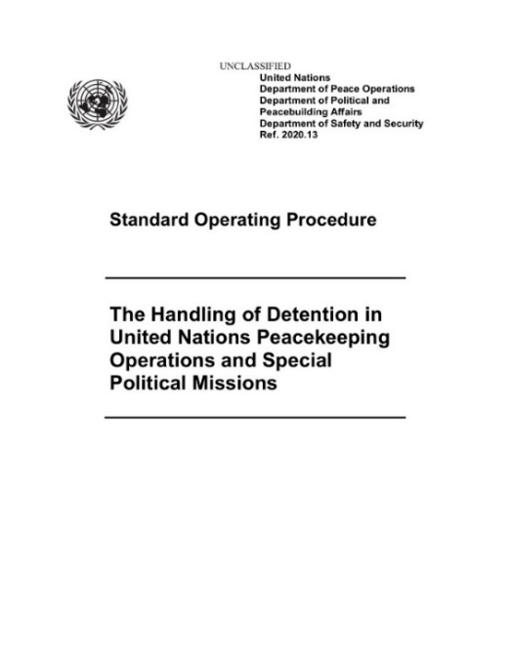
General Principles
Risk assessment & follow up monitoring
Separation of detainees in line with international standards
Apprehension only with due process
Humane treatment during detention
Temporary detention only, then handover or release

Slide 24
Scenario 5
UNPOL decide to apprehend the same persons as outlined in Scenario 1. They are cuffed and secured in UNPOL vehicles.
Question 1
Where should the apprehended persons be brought?
Question 2
Should all three persons be treated under the same regulations?
Question 3
Is there an exception to the answer for question1?

Slide 25
Handover to Host-State Authorities
Handover within 96h (48h for children), otherwise release
Supplement to SOFA/SOMA on general handover guarantees & modalities
DFP initiates handover risk assessment for everyone
HoM to decide on each handover
Host-State warrant and guarantees

Slide 26
No Handover to Host-State Authorities
Real risk of:
Arbitrary killing
Torture/ inhumane treatment
Sexual violence/ threats to life
Death penalty or disappearance
Refoulement
Grossly unfair trial
Participation in hostilities (if a child)

Slide 27
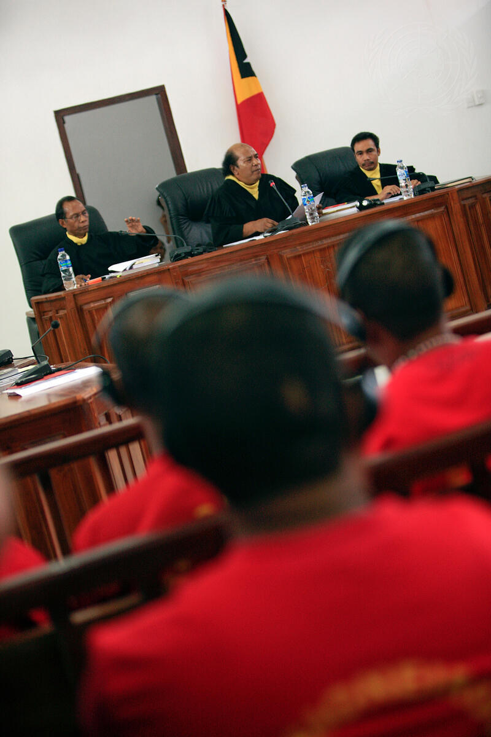
Post-Handover Monitoring
Mission monitors everyone handed over
Regular visits by Human Rights component (or country presence)
Monitoring of trial (within resources)
HoM raises any concerns with host-State

Slide 28
Release
At the maximum permissible length of detention, the Head of Mission shall immediately issue a decision to release the detained person:
Unit commander informs detainee, JOC & DFP
DFP informs host-State & ICRC
Unit Commander returns items and arranges transfer

Slide 29
Summary of Key Messages
UNPOL may apprehend and detain persons within the limits of the mission mandate & DUF (e.g., to protect civilians from a threat).
UNPOL must be aware of applicable rules for detainees regarding their different needs.
UNPOL must comply with the Standard Operating Procedure on the Handling of Detention in United Nations Peacekeeping Operations and Special Political Missions

Slide 30
Questions ?

