Slide 1
Capacity-Building and Development

Slide 2
Aim
To introduce the UNPOL Capacity-Building and Development (CBD) approach

Slide 3
Relevance
Under the SGF any UN Police activity can be allocated to either: Operations or CBD. CBD offers long-term solutions for conflict-related issues and conflict prevention.
CBD is closely related to aspects of local ownership and sustainability. CBD facilitates changes that lead to the intended end-state of sustainable peace. Sustainable peace itself is the requirement for a viable exit strategy of any UNPOL engagement.
2

Slide 4
Learning Objectives
Identify UNPOL CBD activities
Explain the long-term impact of CBD vs. the short-term impact of UNPOL Operations
Discuss the connection between CBD and the intended end-state/exit strategy of UNPOL
State different phases of the CBD process
Illustrate the five areas and five dimensions of UNPOL CBD
3

Slide 5
Lesson Overview
The purpose of UNPOL Capacity-Building and Development
The impact of UNPOL Capacity-Building and Development
The Capacity- Building and Development Process
Capacity-Building and Development Analysis
4

Slide 6
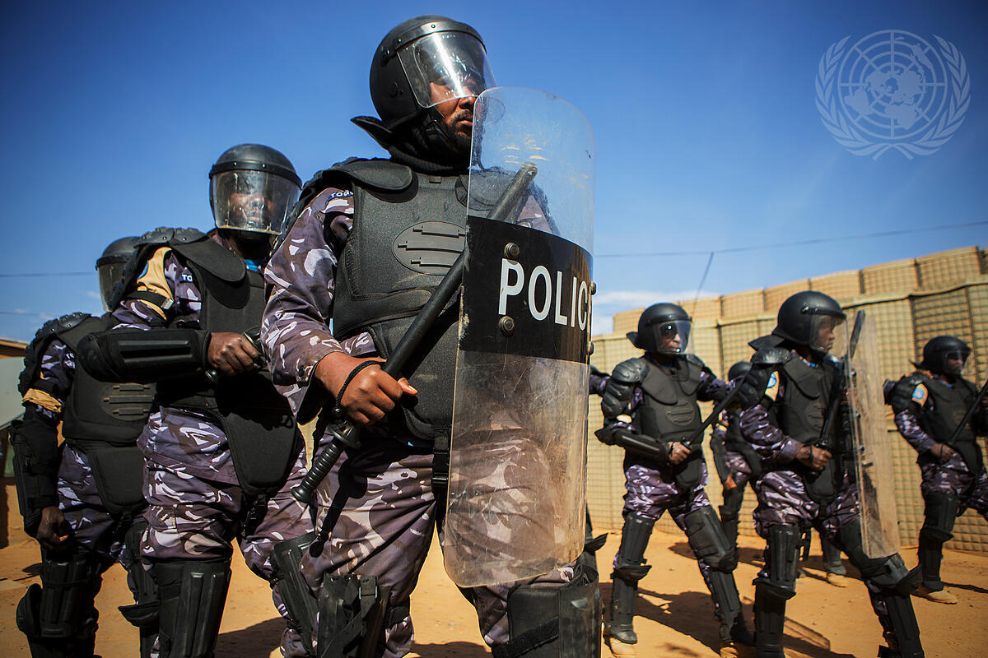
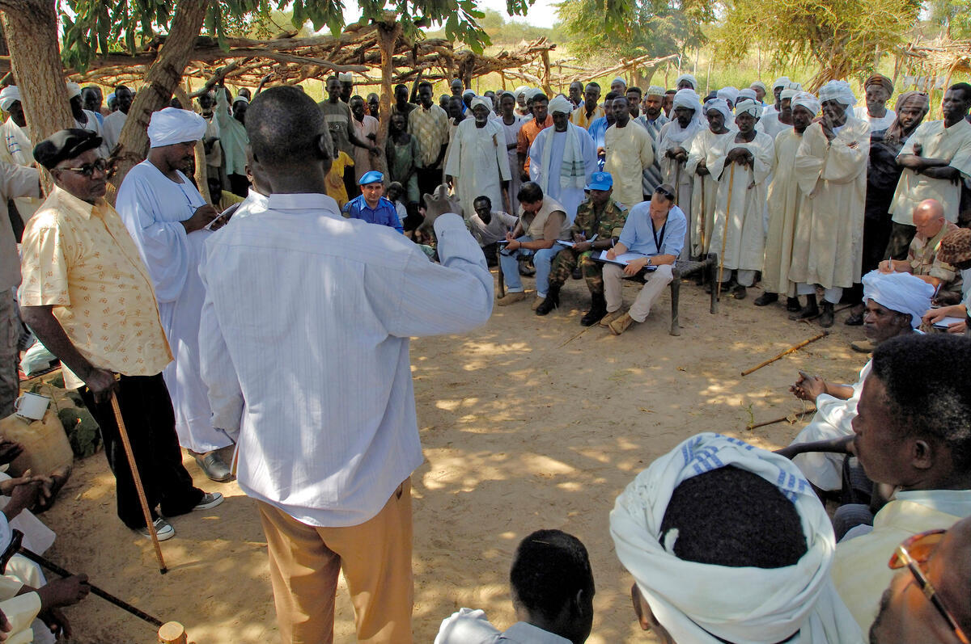
Core UNPOL Priorities
Capacity-Building and Development
Operational Support
Short-Term Impact
Long-Term Impact
5

Slide 7
The CBD Process
Situational Analysis
Transition
Objective setting, Prioritisation & Performance Framework
Complex and Continuous
Evaluation and Adjustment
Planning Activities
Implementation
6

Slide 8
Three Focused Sectors
Situational Analysis
Enabling Environment
Transition
Objective setting, Prioritisation & Performance Framework
Organisational Level
Evaluation and Adjustment
Planning Activities
Individual Level
Implementation
7

Slide 9
Five Areas of CBD Analysis
1
Police professionalism and integrity
2
Administrative systems
3
Legal and policy framework
4
Accountability mechanisms
5
Stakeholder engagement
8

Slide 10
Six Dimensions of CBD Analysis
1
Police practice
2
Environmental sustainability
3
Conflict prevention
4
Human rights
5
Gender
6
Comprehensive POC
9

Slide 11
Areas-Dimensions Matrix
1
Police practice
2
Environ-mental sustainability
3
Conflict prevention
4
Human rights
5
Gender
6
Comprehen-sive POC
Police professionalism and integrity
Administrative systems
Legal and policy framework
Accountability
Stakeholder engagement
10

Slide 12
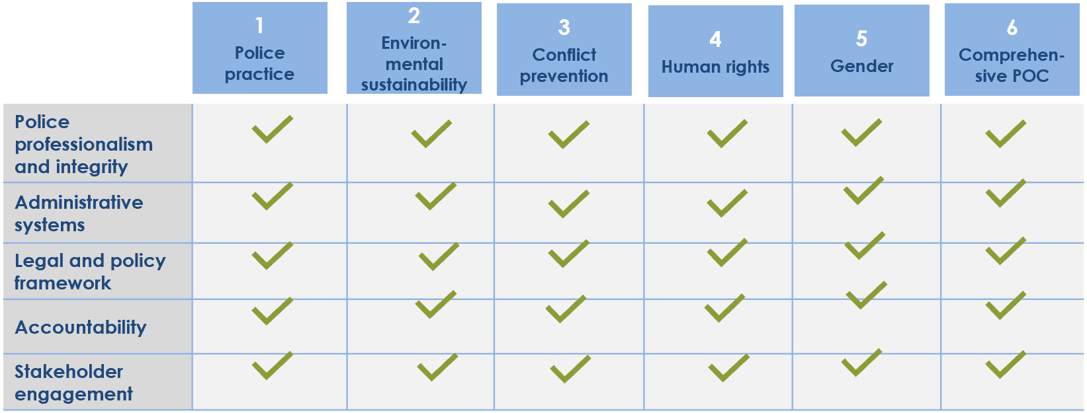
In Context
Situational Analysis
National Law Enforcement Organisation
Transition
Objective setting, Prioritisation & Performance Framework
Evaluation and Adjustment
Planning Activities
Implementation

Slide 13
Carana Learning Activity 4
Instructions
Resources
Carana scenario
Areas-Dimensions Matrix
Work in small groups
Review the Carana scenario
Complete the matrix
Present work in plenary
Group work: 45 minutes
Presentation: 15 minutes
Time: 1 hour

Slide 14
CBD Tools
CBD
Census & Vetting
Training
MMA
Policy Development

Slide 15
Census and Vetting
Identifies the body of personnel
Offers various procedural options
Depends on contextual factors
Rooted in fundamental principles
Challenging and highly sensitive tool

Slide 16
Training
Reduces the gap between individual competence and job requirements
Tailored towards the learning needs
Learning-centred rather than teaching centred
Participatory and adhering to adult learning principles
Constantly evolving based on the idea of continuous improvement

Slide 17
Monitoring, Mentoring and Advising
Monitoring – Allows for recommendations to the host-State on how to build on achievements and address shortcomings in their LEAs
Mentoring – Promotes professional growth and personal motivation through inspiration
Advising – Builds or strengthens the institution, either by helping solve a problem or accompanying the entire reform process

Slide 18
Policy Development
Provides a strong legal and normative basis
Sets standards and landmarks for orientation for other CBD activities
Can help in securing political support
Allows for the introduction of international standards
Requires dissemination of, information and training on and compliance with new rules and regulations

Slide 19
Summary of Key Messages
CBD is one of two core priorities of UNPOL engagement.
CBD offers long-term solutions.
CBD is a challenging, complex and continuous process. It must be addressed within the larger context of security sector reform (SSR), in particular regarding its dependence on the political development.

Slide 20
Summary of Key Messages
A successful CBD process addresses three focused sectors: the enabling environment, the organisational level and the individual level.
The five areas on which UNPOL CBD focuses are professionalism and integrity, administrative systems, legal and policy framework, accountability and stakeholder engagement.
The six dimensions of UNPOL CBD are police practice, environmental sustainability, human rights, gender, comprehensive protection of civilians and conflict prevention.

Slide 21
Questions?

