Slide 1
Police Command in a UN Context

Slide 2
Aim
To familiarize the participants with the UN Police command structure in peacekeeping operations and to raise awareness of the accountability system in a UN context

Slide 3
Relevance
All IPOs are affected by the SGF Guidelines on Command in Peace Operations, be it as member of a unit/section/team or as a (potential) UN Police Commander.
UN Police Command Staff need to be operationally competent and knowledgeable in UN policing practices that comply with the Strategic Guidance Framework for International Police Peacekeeping.
The Guidelines include principles for any UN Police Commander tasked to lead officers from different countries with very different policing styles. They provide guidance for the unique challenges this operating environment presents in the context of collaborating with the host-State police service and other elements of the operation.
Accountability plays a key role for Police Commanders and all UN Police Officers.

Slide 4
Learning Objectives
Illustrate the importance of effective leadership in the UN mission environment
Describe the three levels of leadership and authority
List to whom the UN Police Officers are accountable

Slide 5
Lesson Overview
Leadership, Management, and Command in a UN Context
Levels of Authority and Chain of Command
UN Leadership Functions
Accountability and Oversight

Slide 6
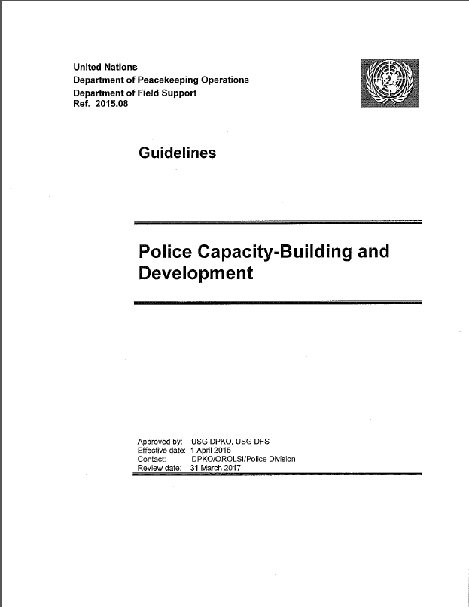
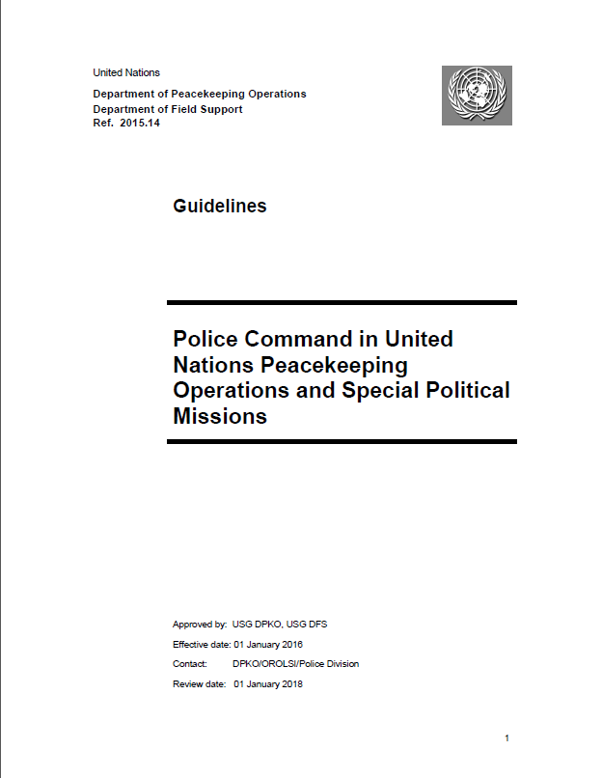
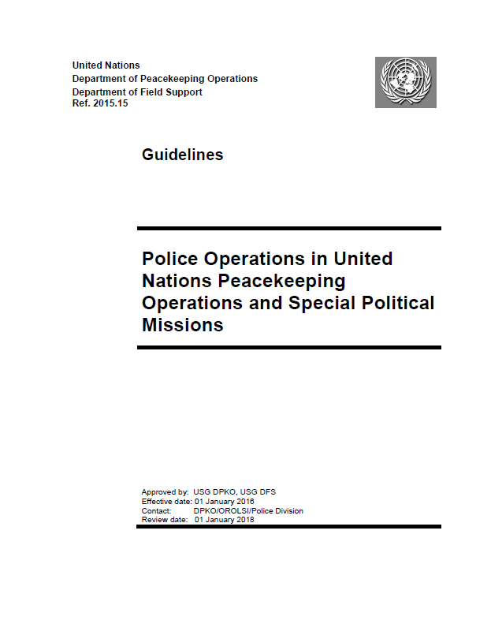
Strategic Guidance Framework for International Policing
Strategic Guidance Framework
for International Policing
Guidelines on Police Administration
Guidelines on Police Capacity-Building and Development
SGF
Policy on United Nations Police
Guidelines on
Police Command
Guidelines on Police Operations

Slide 7
Learning Activity 2.1
Instructions
Discuss in your groups: What is the difference between leadership in domestic policing compared to international policing?
  Time: 20 minutes
  Discussion:10 minutes
  Feedback: 10 minutes

Slide 8
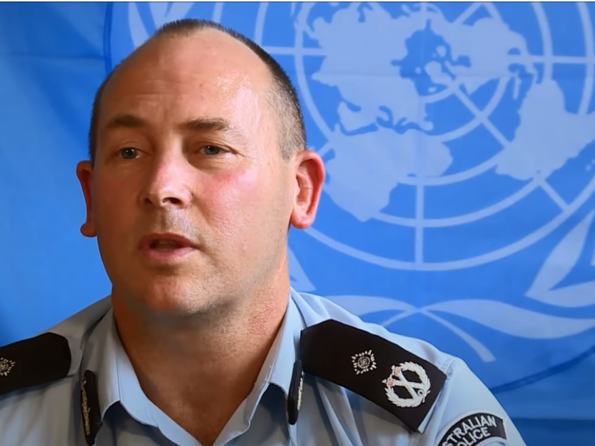

Leadership in a UN Context
“The UN is unlike many contemporary national police services…having to work and respond in often complex, but weak political, environmental, social, technological, economic and legal context; and in conflict and post-conflict situations. This is not the norm for many police officers from police-contributing countries”
~Greg Hinds, Police Commissioner, UNMIL

Slide 9

Chain of Command
DECIDES
UNHQ
SECURITY COUNCIL
IMPLEMENTS
SECRETARY-GENERAL
DELEGATED AUTHORITY
ADVISE
USG DPO
Office of Operations
MILITARY ADVISER
POLICE ADVISER
STRATEGIC
COORDINATES
OPERATIONAL
TECHNICAL LINK
OVERSIGHT
HEAD OF MISSION
SRSG
UN AUTHORITY IN THE FIELD
FIELD
POLICE
COMMISSIONER
FORCE
COMMANDER
TACTICAL

Slide 10
Chain Of Command – Police
HOPC
Deputy PC
Capacity Building & Development
Chief of Staff (Administration)
Deputy PC
Operations
Strategic Planning
Community Engagement
Monitoring and Evaluation
Project Oversight
Accountability
Public Affairs/Outreach
Focal Point: Logistics
Conduct and Discipline
Focal Point: Procurement
Human Resources
Focal Point:
Finance
ICT
Induction and Training
Records Management
Staff Welfare
Policing Services
Enabling Services
Policy Formulation on Policing
Accountability/
Governance
Stakeholder Engagement
Public Safety
Investigations
Special Operations
Community-Oriented Policing

Slide 11
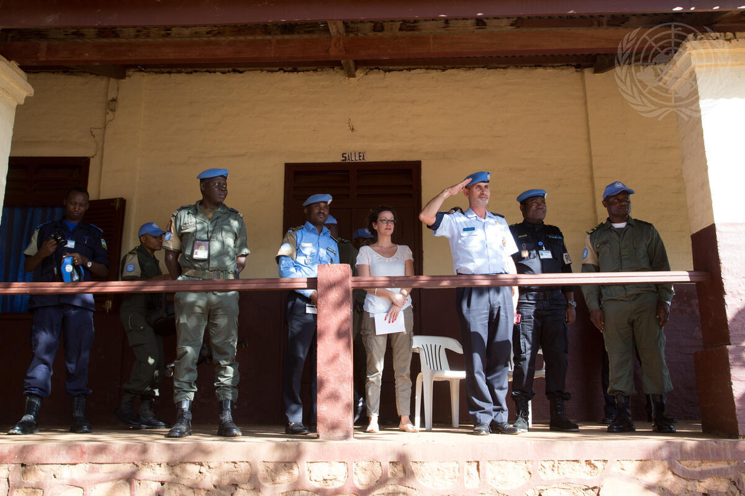
Strategic Leadership
Supports the long-term vision and mission of the UN and UN policing
Provides the environment
for personnel growth and accomplishing the organisation’s strategic goals

Slide 12
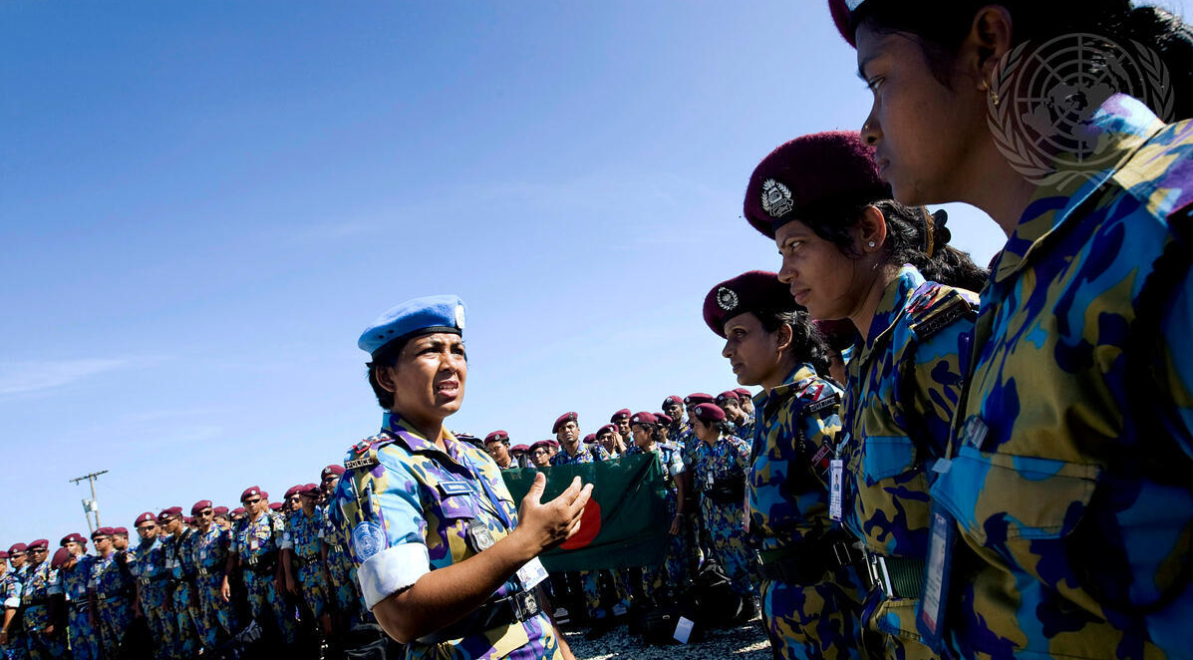
Operational Leadership
Provides the structure and systems that allow the organisation’s vision and specific mission to be achieved
The HOPC uses the Police CONOPS to develop the Police Operation Plan (OPLAN)―critical for planning and conducting police activities

Slide 13
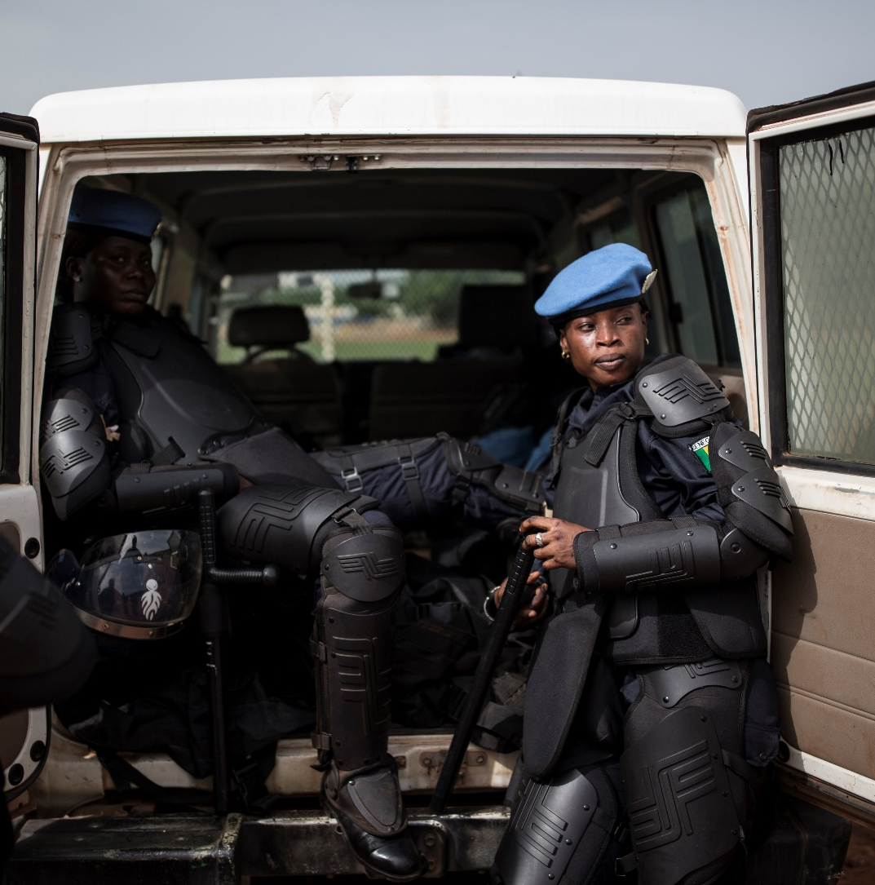
Tactical Leadership
Tactical leadership concerns the HERE and NOW accomplishment of immediate objectives. It may require risk-based decision-making, weighing the needs of the mission against the needs of the unit.
Implementation of the Police OPLAN

Slide 14
UN Police/Military Cooperation
Critical for success of Peace Operations
Each has different responsibilities, organisation, command structure and tactics
Joint police/military task force
Mutually Supportive Operations
Joint contingency planning, training and exercises
Police Command
Military Command
Avoid transfer of operational command

Slide 15
Learning Activity 2.2
Instructions
Discuss in your groups: What does accountability mean to you and why is it important to Law Enforcement Officials?
Who are we accountable to?
  Time: 20 minutes
  Discussion:10 minutes
  Feedback: 10 minutes

Slide 16

Accountability and Oversight
Internal and external checks and balances ensure the performance of police functions is of the highest standard and that officers are held responsible
  Prevention of misusing police power
  Enhancing public confidence
  Reestablishing police legitimacy
  Reporting on ALL incidents
  Stakeholders

Slide 17
Accountability and Oversight
Host
Government
and Police
Police and other personnel in own component
Police Commander
Other Mission Components
and external stakeholders
SRSG/Head
of Mission

Slide 18
Summary of Key Messages
There are three levels of authority for decision-making in UN peacekeeping – strategic, operational and tactical. These levels are also known as levels of authority, command and control (AC2).
Command and leadership in a domestic setting fundamentally differs from leadership in UN Policing.
Police and Military components in United Nations Peace Operations have different responsibilities, organisation, command structure and tactics and must be separate.
Accountability refers to a system of internal and external checks and balances aimed at ensuring that police perform their functions to the highest standard and are held responsible if they fail to do so.

Slide 19
Questions

