Slide 1

Module 3: Individual Peacekeeping Personnel
Lesson
3.10
Stress Management

Slide 2

Relevance
Be aware:
High-risk areas or crisis operations
Need to carry out work without adverse effect
Work/life balance
UN Core Pre-Deployment Training Materials 2017

Slide 3
Learning Outcomes
Learners will:
Identify symptoms of negative stress
List sources of stress
Explain different types of stress
Describe stress management techniques and coping methods
UN Core Pre-Deployment Training Materials 2017

Slide 4
Lesson Overview
Definition of Stress
Useful versus Harmful Stress – Positive versus Negative Stress
Sources of Stress
Types of Stress
Coping with Stress
UN Core Pre-Deployment Training Materials 2017

Slide 5
Learning Activity
3.10.1
Job-related Stress
Instructions:
Consider your work as peacekeeping personnel
Why are you at risk of stress due to your job?
List other high-risk jobs and draw comparisons
Discuss the importance of self-care
Time: 10 minutes
Group work: 5-7 minutes
Discussion: 3 minutes
UN Core Pre-Deployment Training Materials 2017

Slide 6

1. Definition of Stress
Stress: any change or demand that the human system (mind, body, spirit) is required to meet or respond to
Stress is simply the body’s response to changes that create taxing demands
Stress is not always a bad thing
UN Core Pre-Deployment Training Materials 2017

Slide 7
2. Useful versus Harmful Stress –
Positive versus Negative Stress
In the presence of a threatening or dangerous situation, the person reacts with the “fight or flight” response
Distress: any stress that occurs too often (frequency), lasts too long (duration) and is too severe (intensity)
A consequence of long-term distressors or daily cumulative (negative) stress is “breaking down”
UN Core Pre-Deployment Training Materials 2017

Slide 8
2. Useful versus Harmful Stress –
Positive versus Negative Stress
Common Symptoms of Negative Stress
Physical | Psychological | Behavioural
Fatigue Back pain Headache Ulcer | Memory loss Poor concentration Decrease in esteem Depression | Verbal outburst Increased smoking Increased alcohol use Eating disorders
UN Core Pre-Deployment Training Materials 2017

Slide 9
3. Sources of Stress
Sources of Stress
Environment
Organizational Environment
Interpersonal Factors
Personality Factors
Biological Factors
Psychological Factors
UN Core Pre-Deployment Training Materials 2017

Slide 10
4. Types of Stress
In normal situations
Basic Stress
Cumulative Stress
In abnormal situations
Traumatic/Critical Incident Stress
Post-Traumatic Stress Disorder (PTSD)
UN Core Pre-Deployment Training Materials 2017

Slide 11
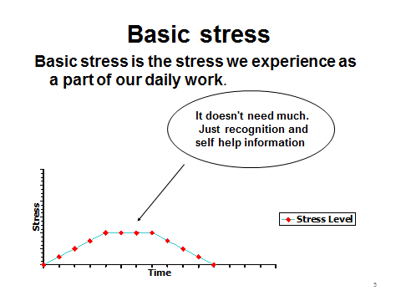
Basic Stress
UN Core Pre-Deployment Training Materials 2017

Slide 12
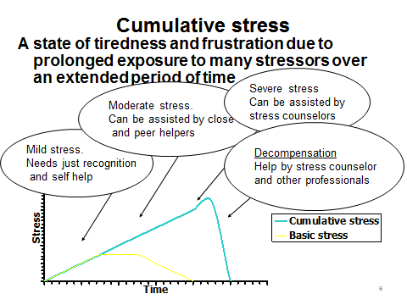
Cumulative Stress
UN Core Pre-Deployment Training Materials 2017

Slide 13
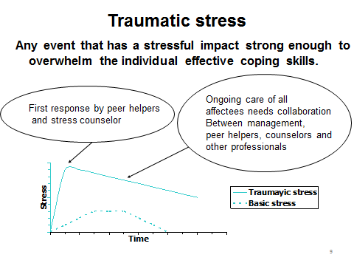
Traumatic/Critical Incident Stress
UN Core Pre-Deployment Training Materials 2017

Slide 14
Post-Traumatic Stress Disorder (PTSD)
A result of symptoms of traumatic/critical incident stress lasting more than a month
A more serious condition
Diagnosis and treatment by a specialist
UN Core Pre-Deployment Training Materials 2017
Notes:
No need to type out explanations

Slide 15
Learning Activity
3.10.2
Personal Stress Profile
Instructions:
What are the sources of stress in your life?
What symptoms of negative stress do you experience?
List negative ways you deal with stress
List positive ways to manage stress
Time: 15 minutes
Intro and close: 3 minutes
Individual work: 12 minutes
UN Core Pre-Deployment Training Materials 2017
Notes:
CPTM 3.11.1

Slide 16
5. Coping with Stress
ABC Strategy
A = Awareness
B = Balance
C = Control
Important to recognize the source of negative stress
Know yourself and your limits to manage stress effectively
Managing stress is all about taking control of your life
UN Core Pre-Deployment Training Materials 2017

Slide 17
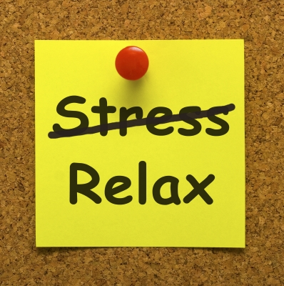
Stress Management Techniques
Change your thinking
Change your behaviour
Change your lifestyle
UN Core Pre-Deployment Training Materials 2017

Slide 18
Maladaptive Coping
Occurs when normal coping mechanisms do not work or when stress is inappropriately dealt with
Damaging to our health and welfare in the long run
Substance abuse (drugs, self-prescribed medicine, alcohol, coffee) and behavioural modification (stress sex, overeating)
UN Core Pre-Deployment Training Materials 2017

Slide 19

Additional Help & Resources
Contact your staff counselor, medical service, UN examining physician and peer support personnel
Discuss with a trusted friend and/or family member
Managers should be aware
Work as a team with your colleagues
UN Core Pre-Deployment Training Materials 2017

Slide 20
Summary of Key Messages
Symptoms of negative stress – physical, psychological, behavioural
Sources of stress – environment, interpersonal, personality, biological, psychological factors
Different types of stress – general, cumulative, traumatic/critical incident, PTSD
ABC strategy – awareness, balance, control
UN Core Pre-Deployment Training Materials 2017

Slide 21
Questions
UN Core Pre-Deployment Training Materials 2017

Slide 22
Learning Activity
Learning Evaluation
UN Core Pre-Deployment Training Materials 2017

